Slide 1
Incremental Data Load Pipeline
Mysql (Onprem) > ADF > Azure SQL Database
Incremental data = At first initial load data is there in the AzureSQL database. As new records updated on onprem we need to just update that records on azuresqldatabase.This updated data is incremental data.

Slide 2
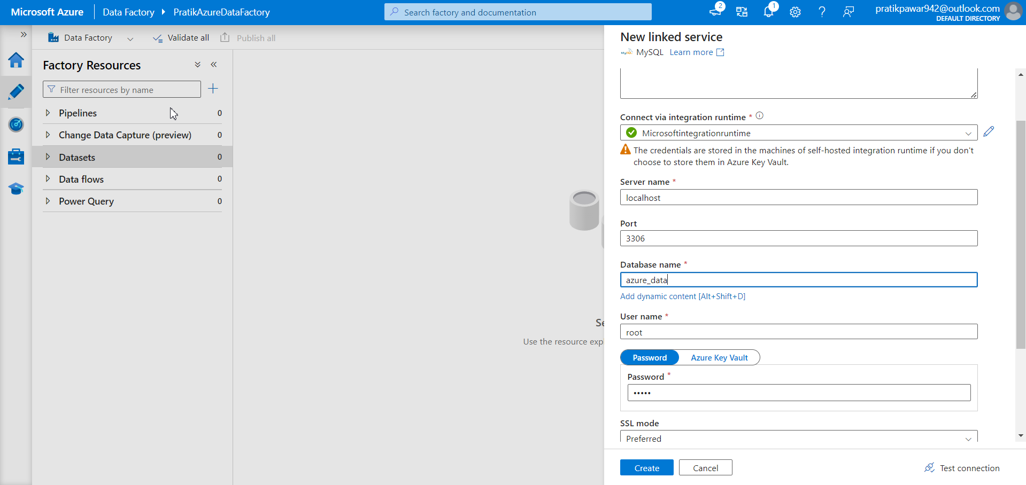
Create a linked service between Onprem sql and ADF

Slide 3
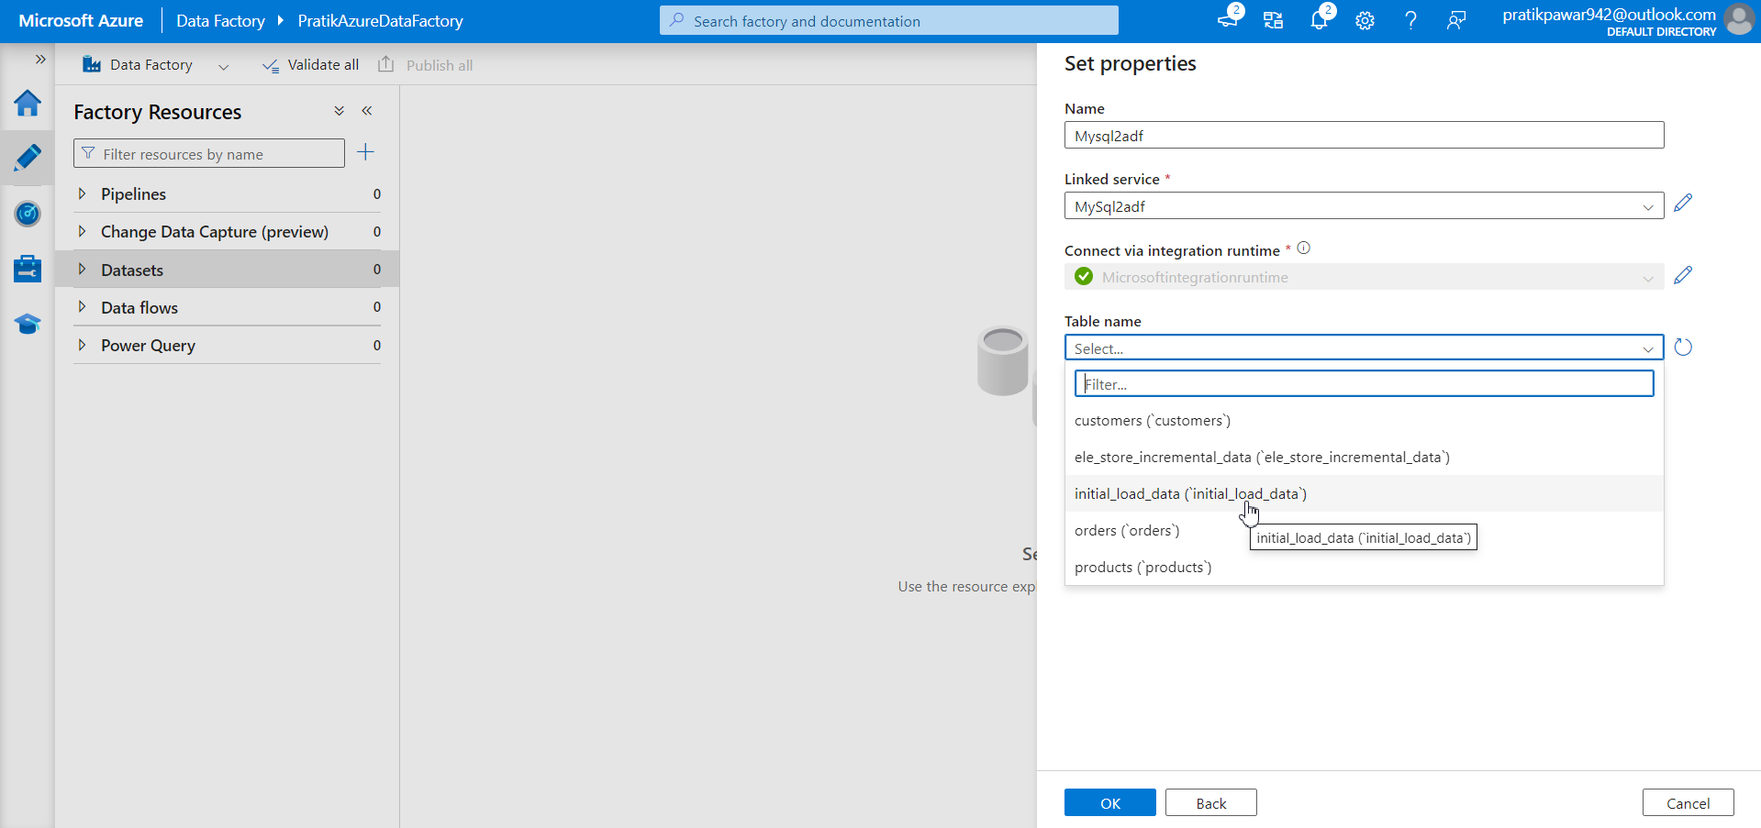
Transfer the initial Load Data through pipeline in ADF

Slide 4
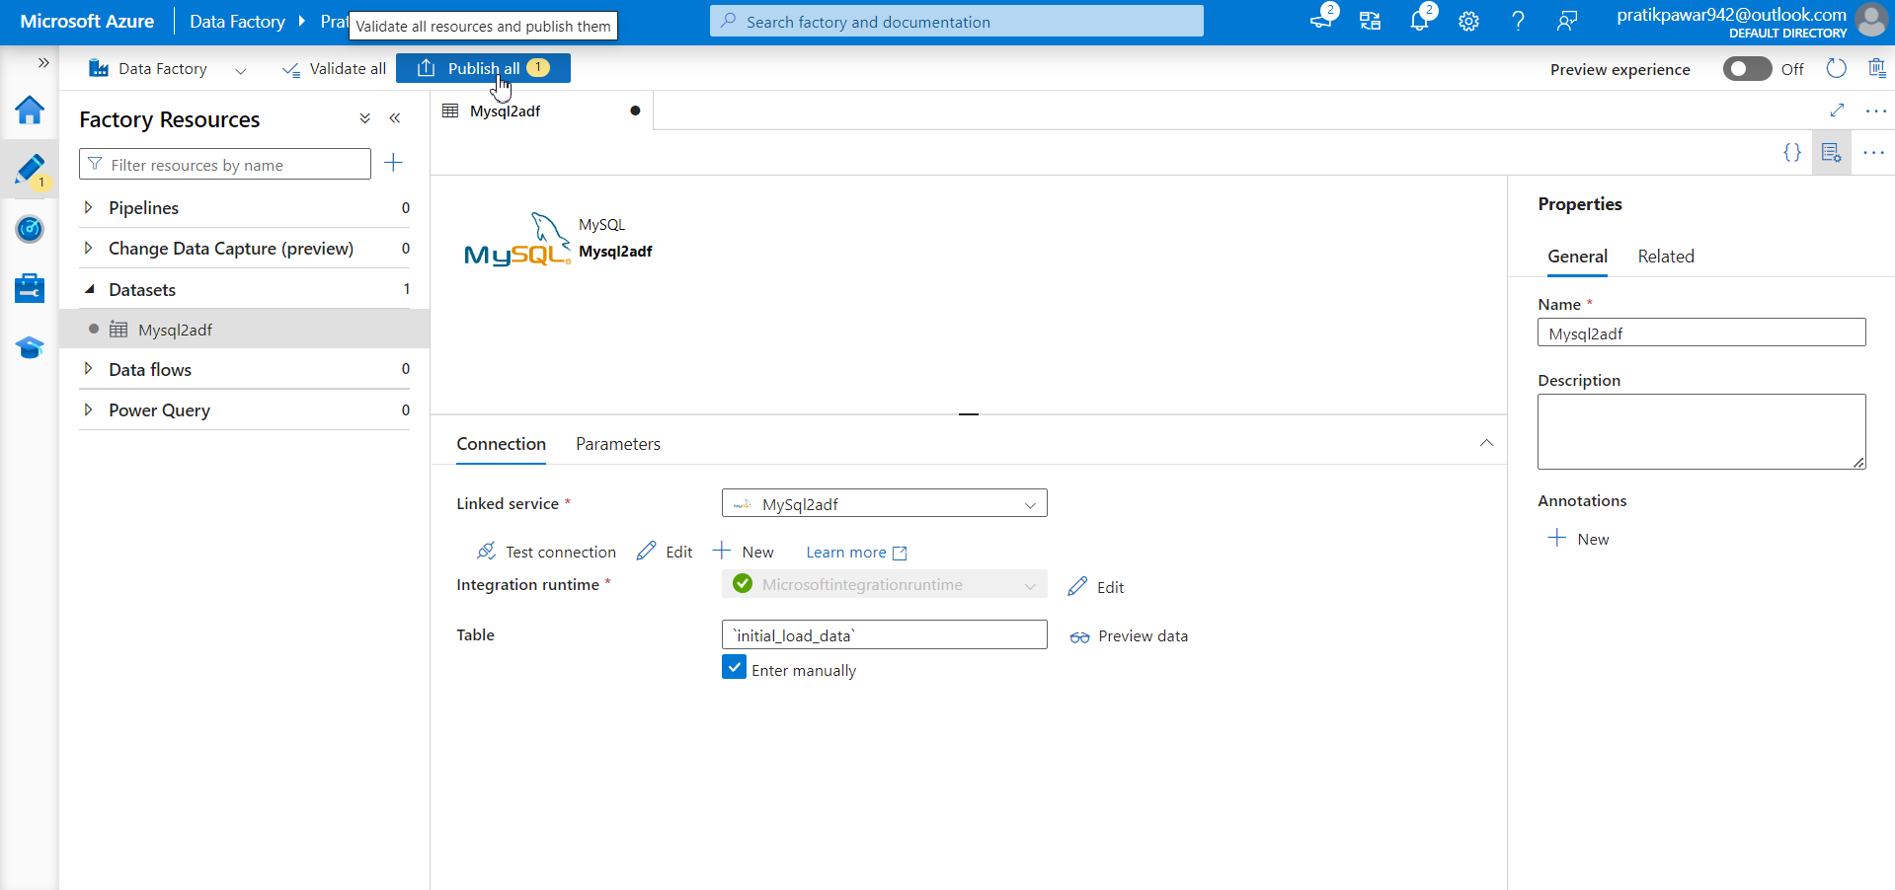
Publish

Slide 5
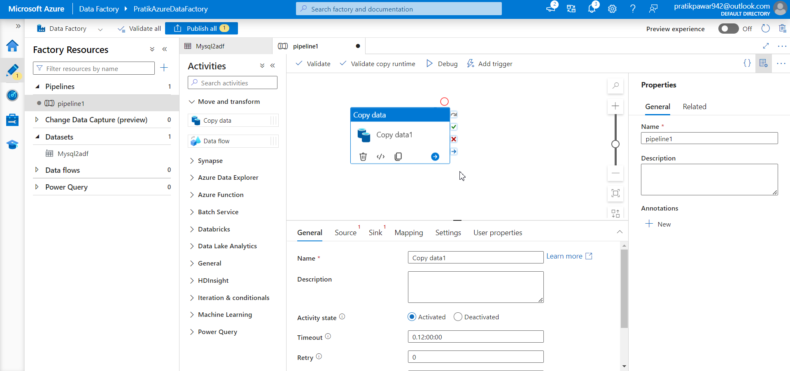
New Pipeline = Copy data

Slide 6
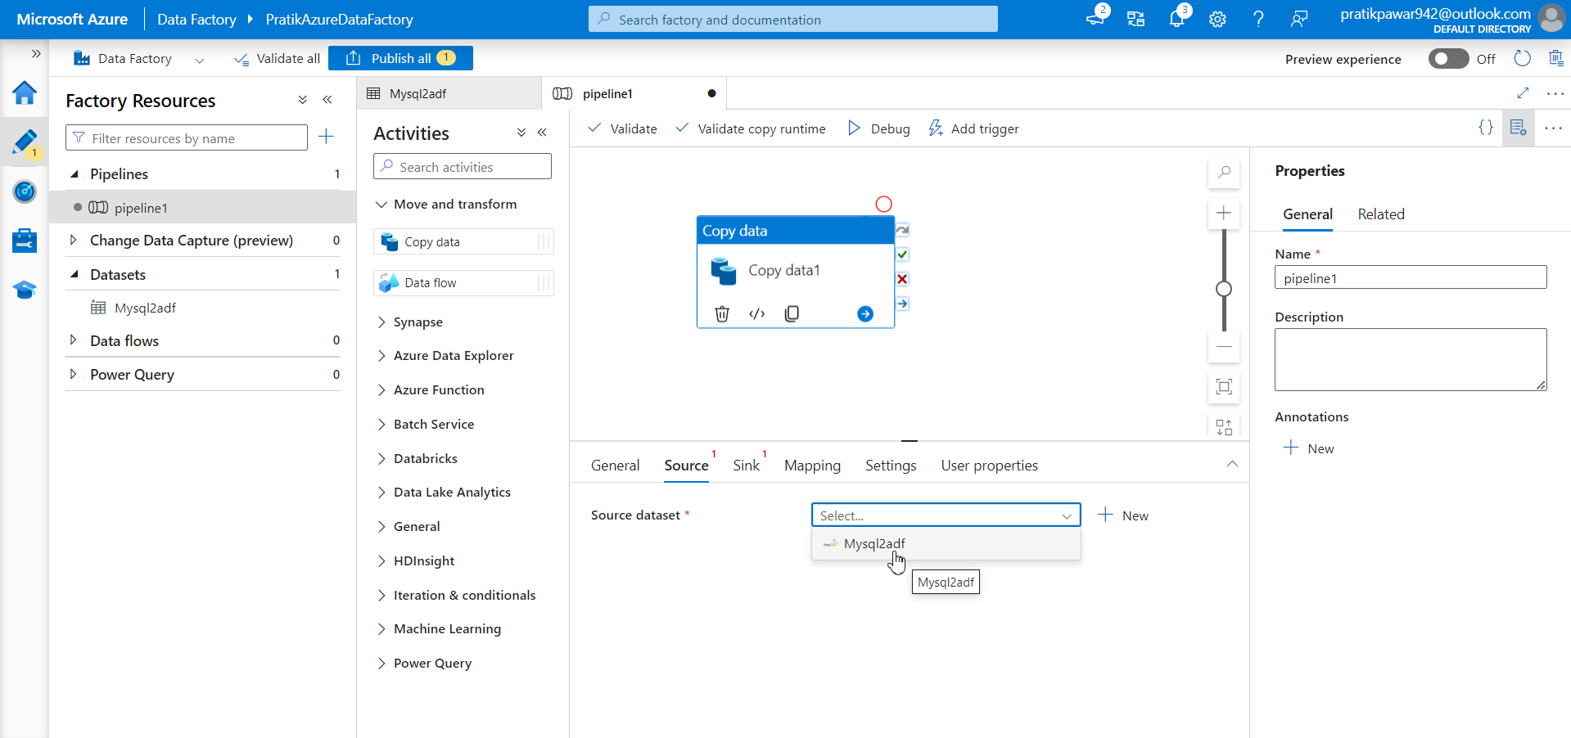
Select Source

Slide 7
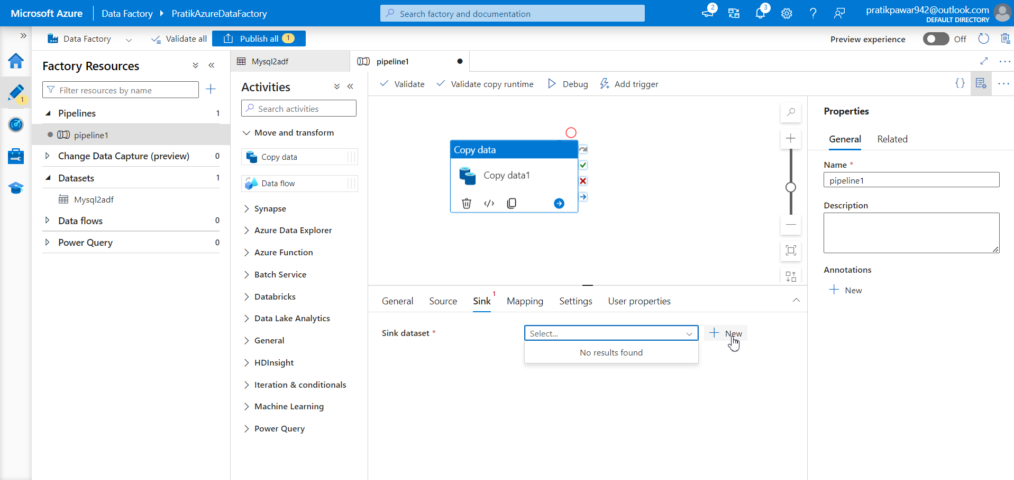
Create Sink ie AzureSQL database

Slide 8
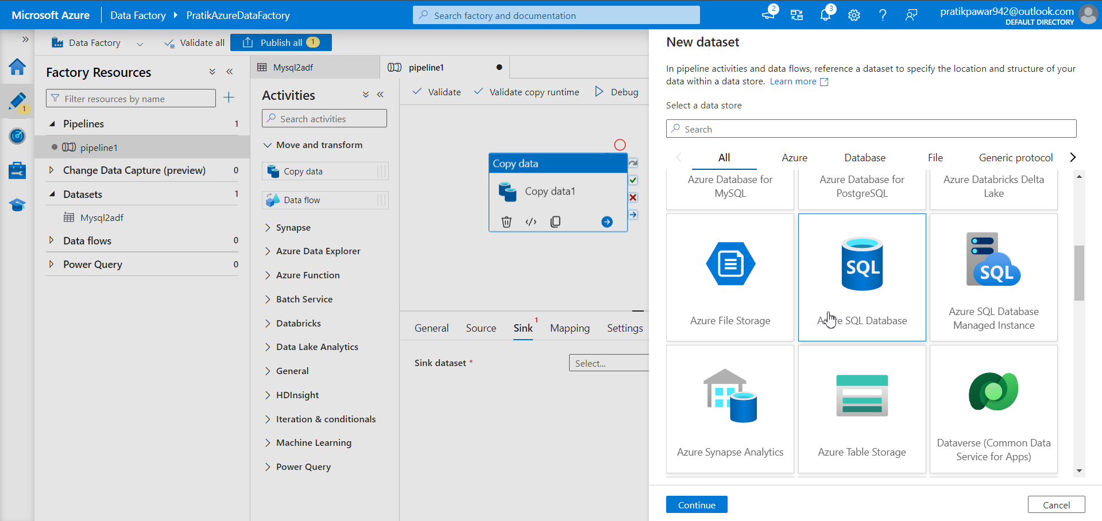
Azure SQL Database

Slide 9
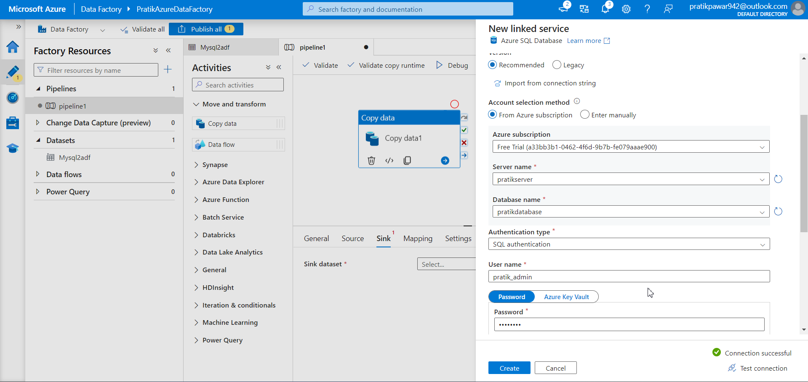
Fill the info and test the connection

Slide 10
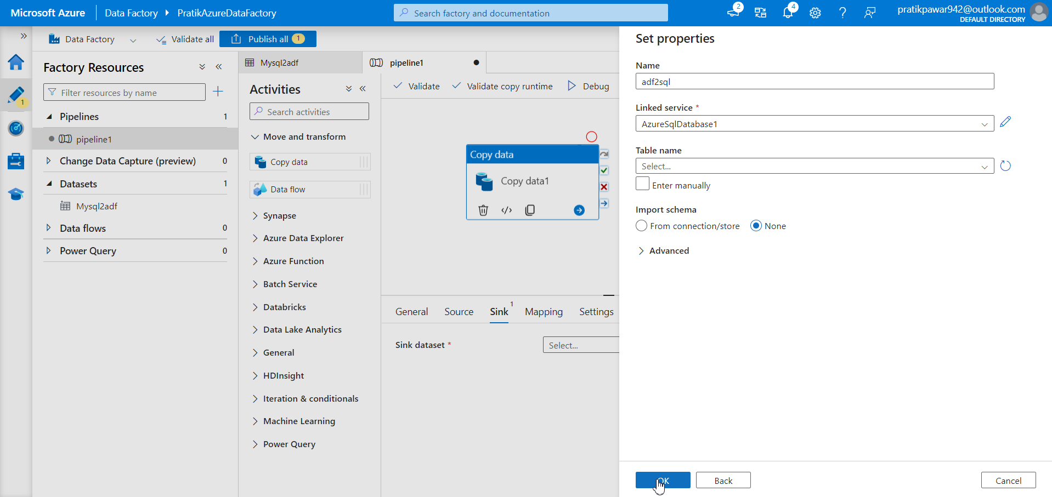
OK

Slide 11
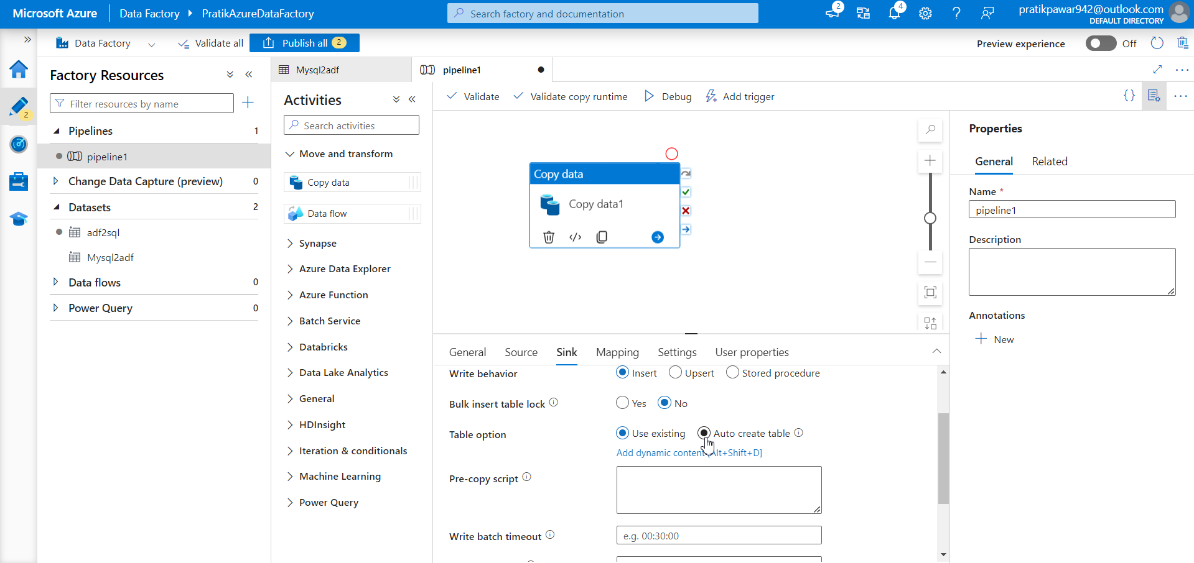
Auto Create Table

Slide 12
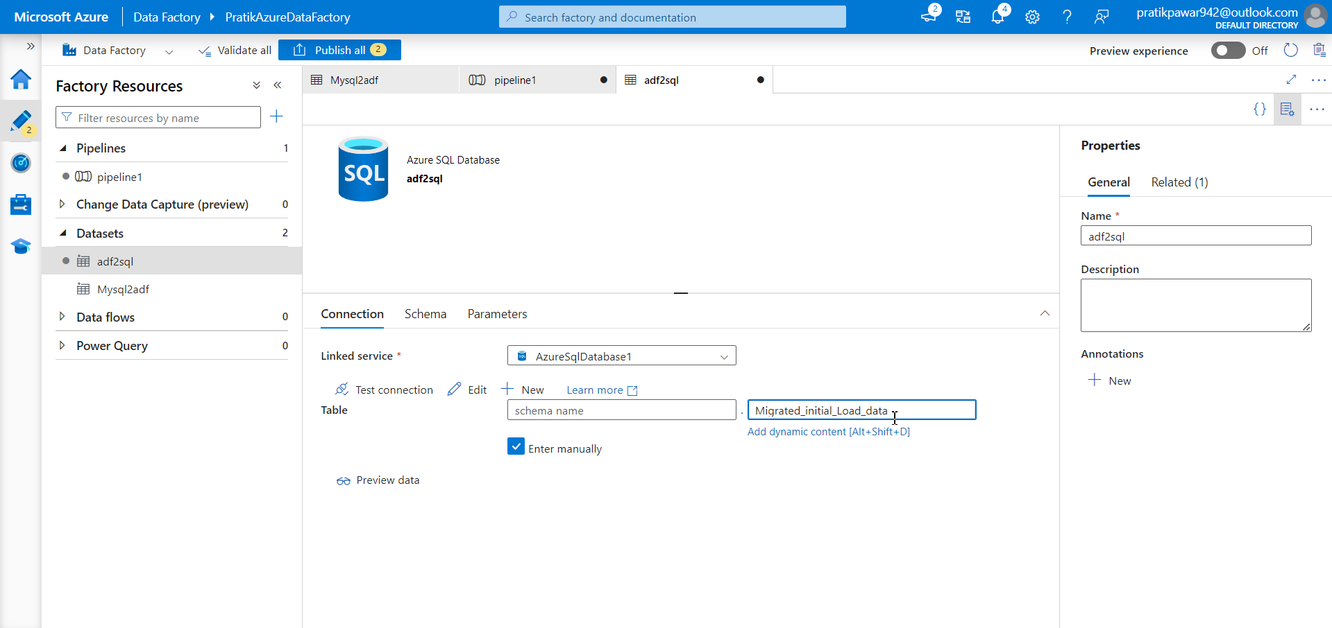
Give the name of table which we want after migration in Azure SQL Database

Slide 13
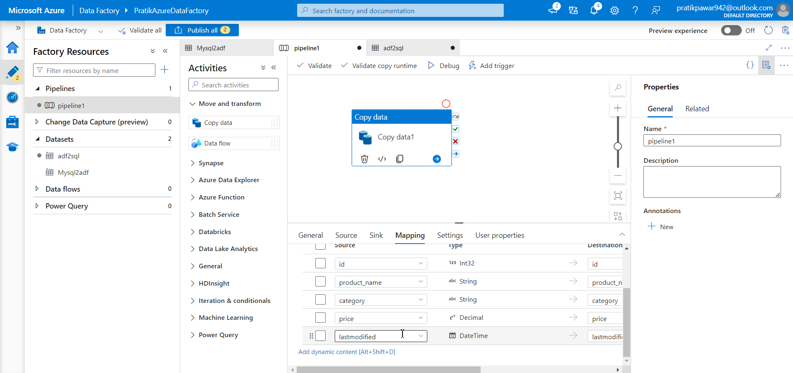
See Schema check all columns

Slide 14
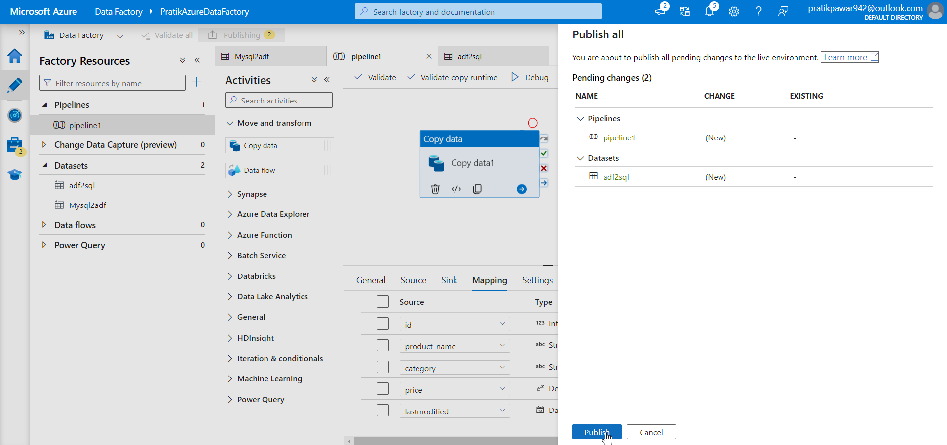
Publish

Slide 15
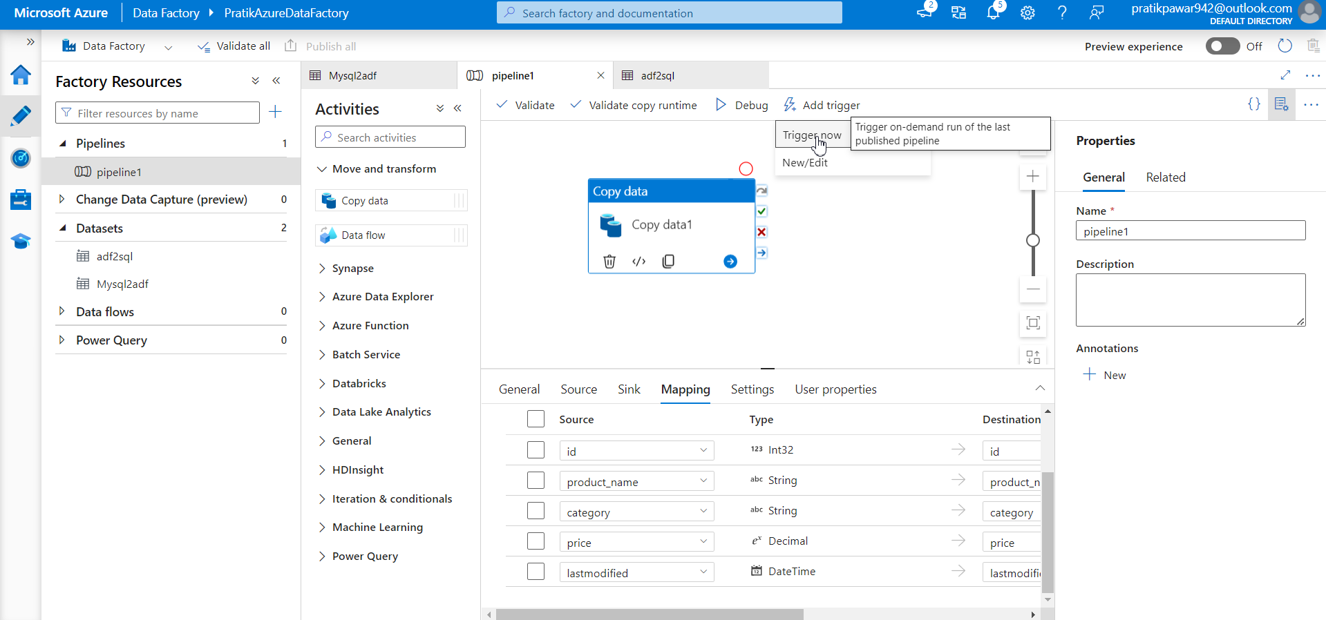
Trigger Now

Slide 16
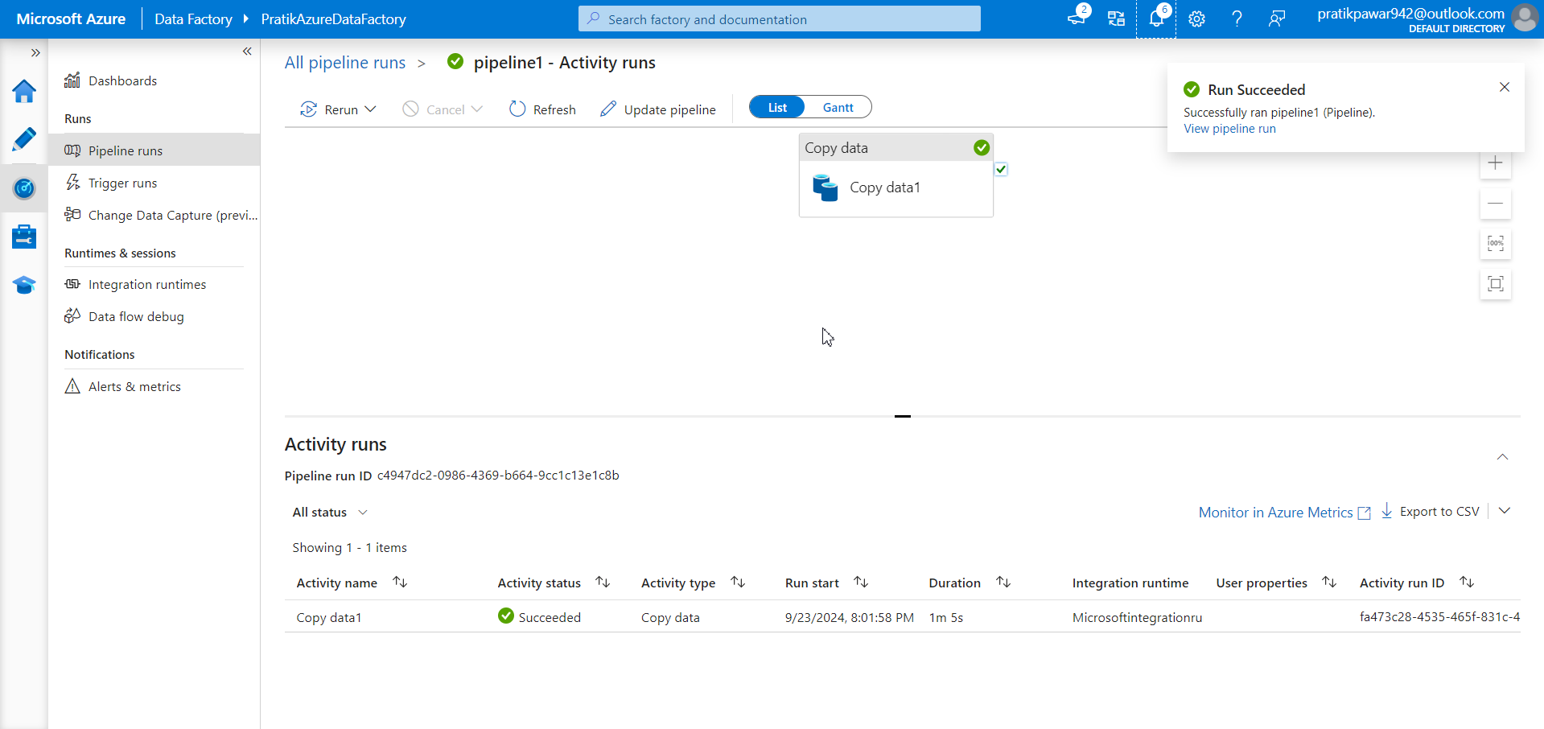
Now after this when new data has came in onprem mysql, rather than deleting all this adding new data we need to insert only new data ie incremental data

Slide 17
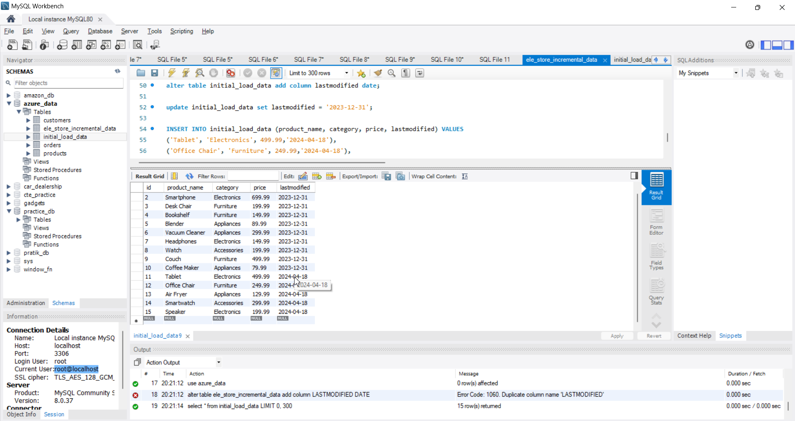
Now in this table 5 new records has been added and we have to upload this incremental data in Azure SQL Database without deleting old records using ADF

Slide 18
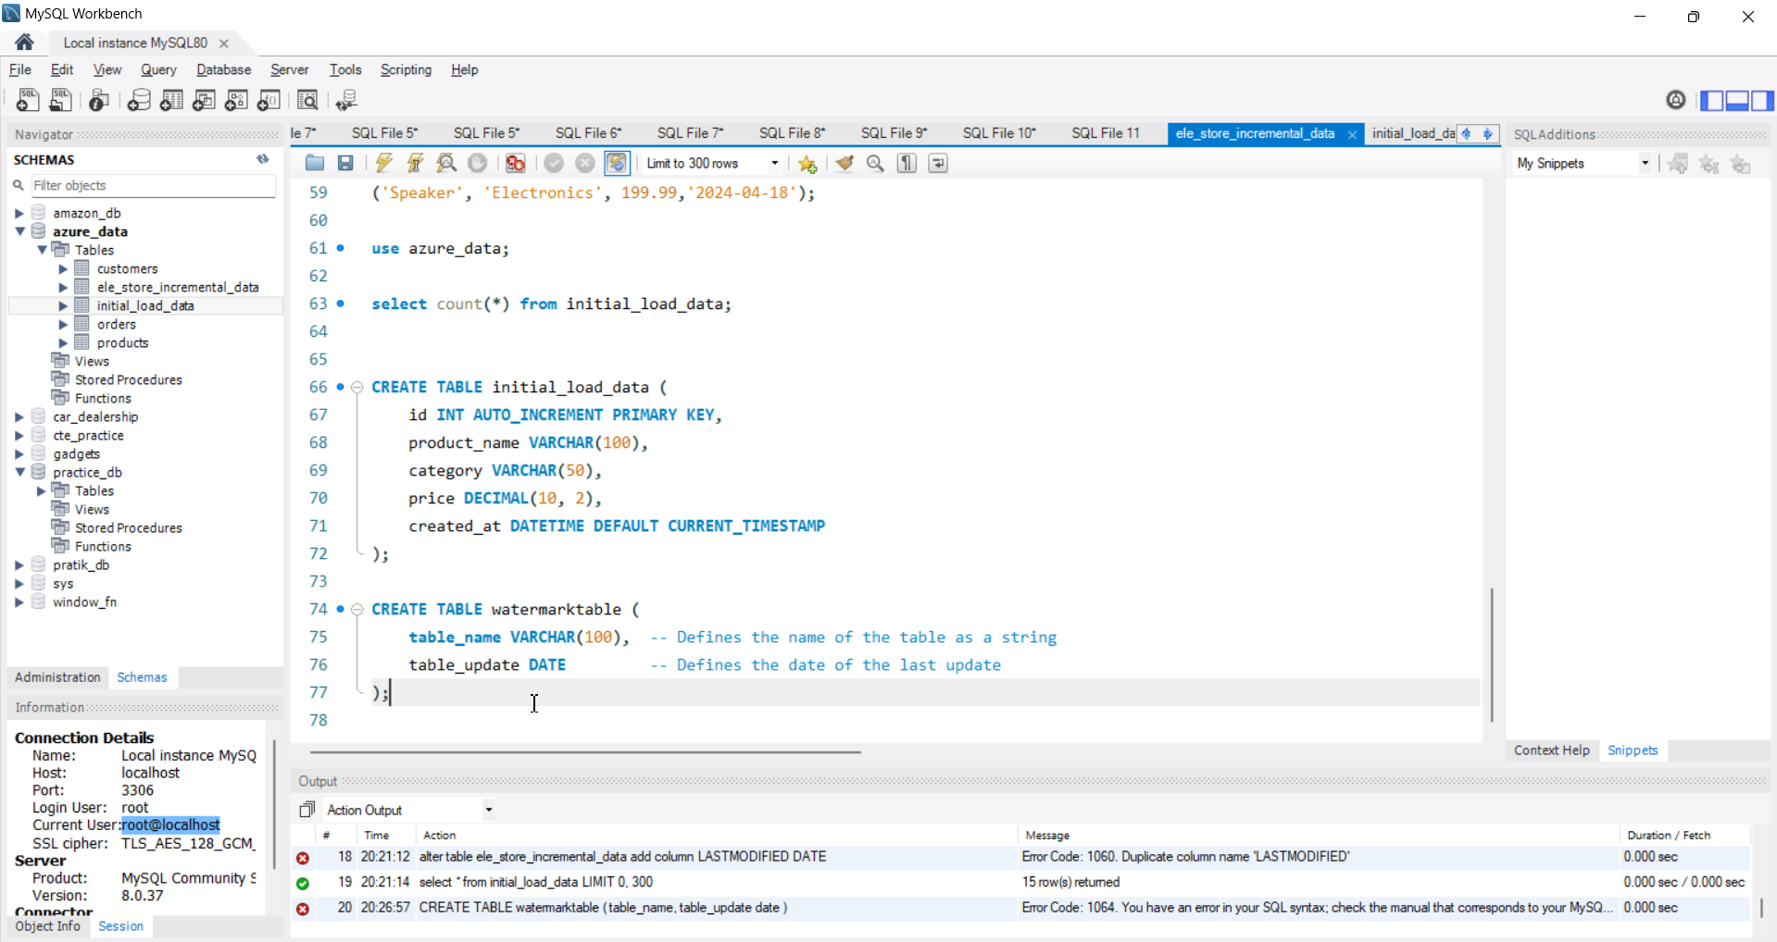
Now create table watermark which info about last updated dates to new updated data

Slide 19
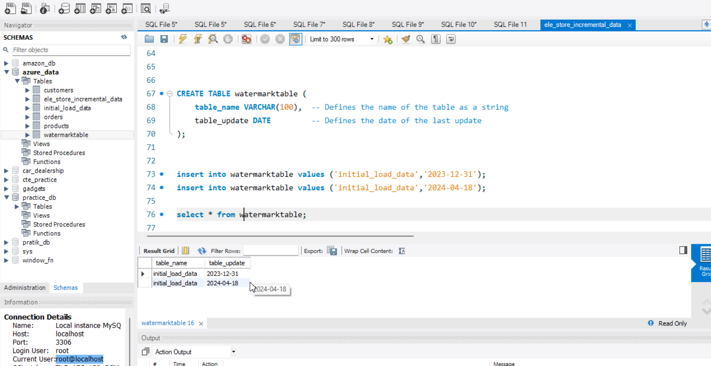
Watermarktable ( old updated date and new updated date) (Remember – Incremental load only works when you have DATE TIME column in it otherwise it will not work)

Slide 20
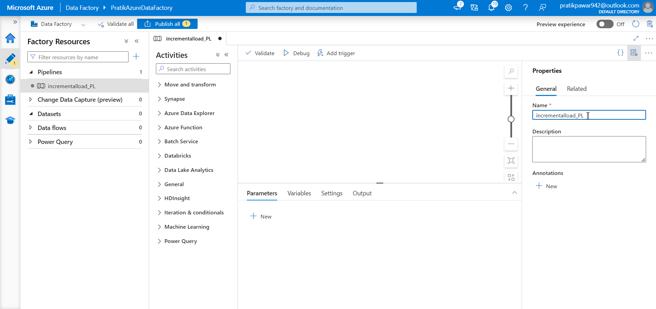
Create one pipeline and name as ‘incrementalload_PL’

Slide 21
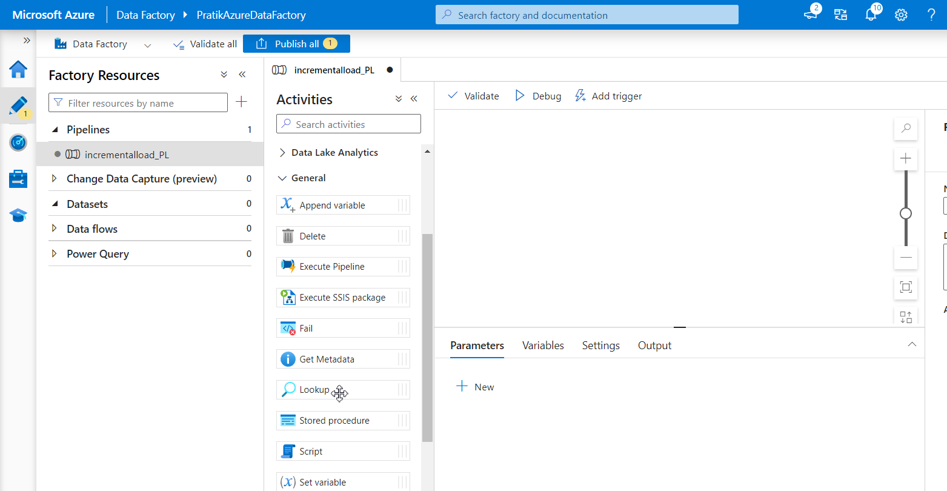
In Azure Data Factory (ADF), the Lookup activity is used to fetch data from a source, like a database or file, and use that data in other steps of a pipeline.

Slide 22
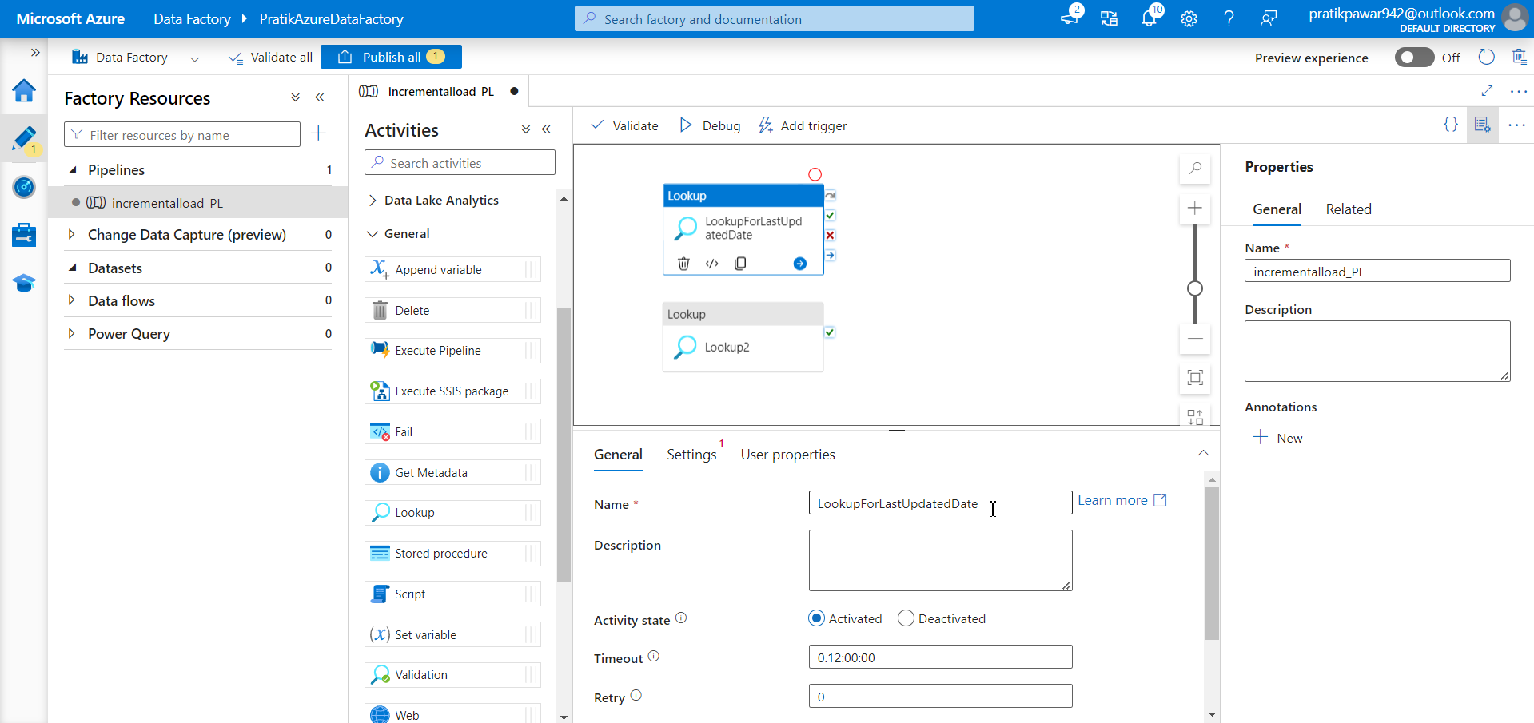
Take two look name one as ‘lookupforLastUpdatedDate’

Slide 23
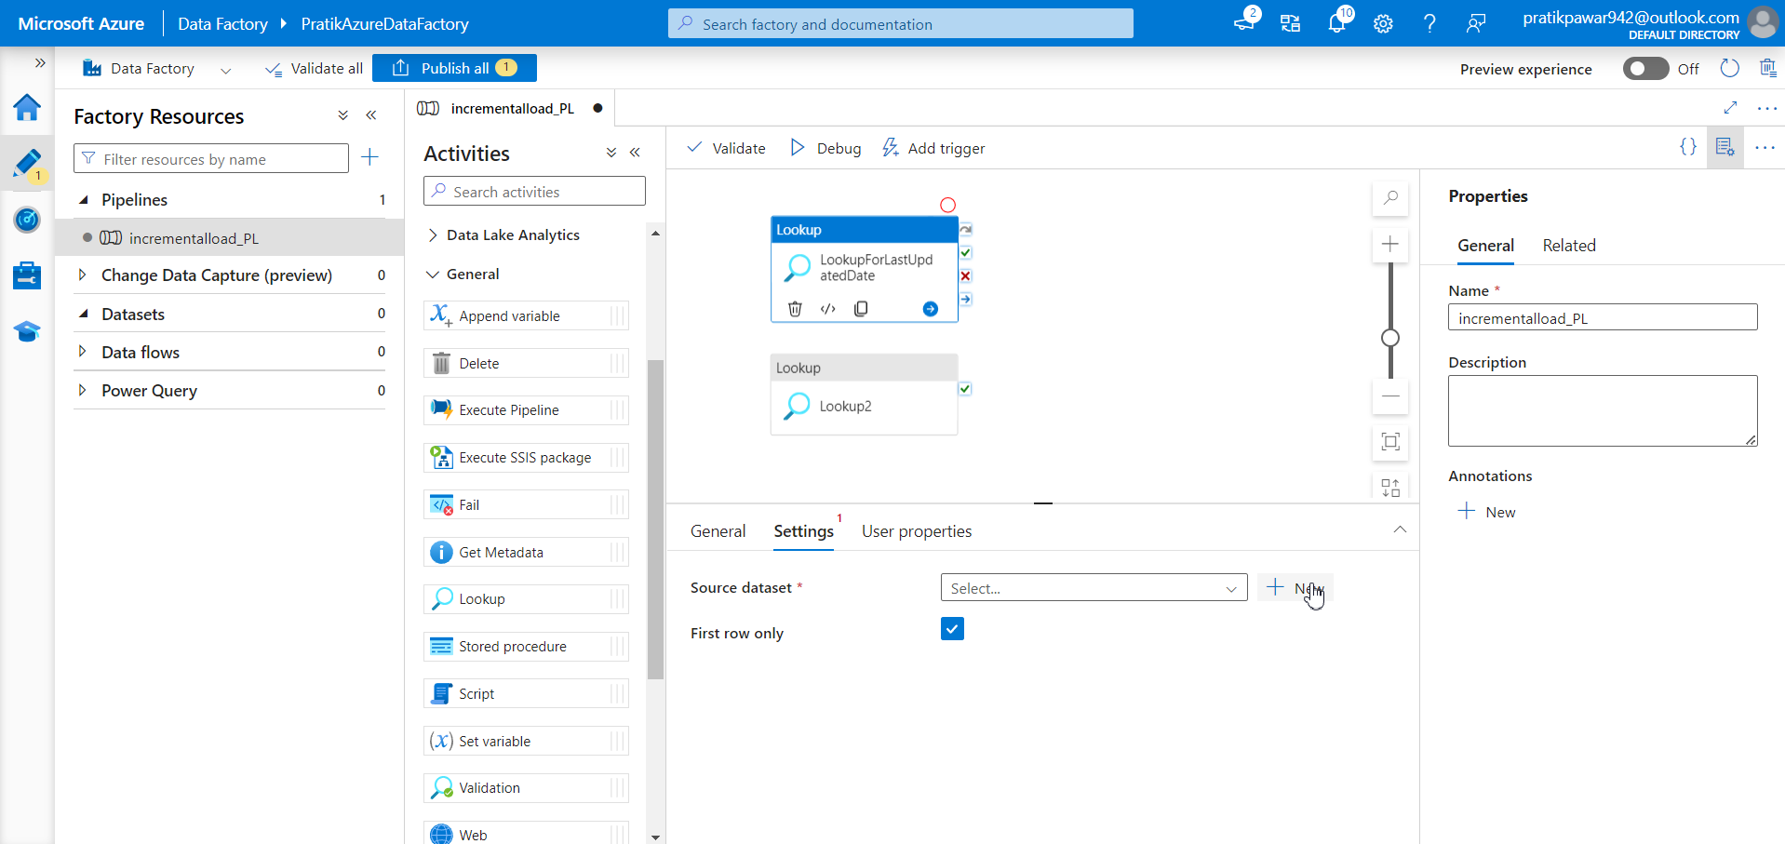
Now go to setting and add source for first lookup

Slide 24
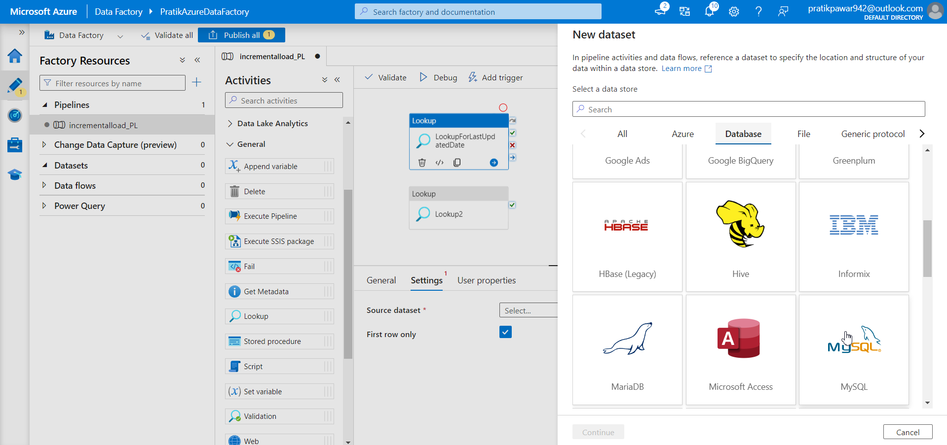
Its should be watermark table from onprem mysql

Slide 25
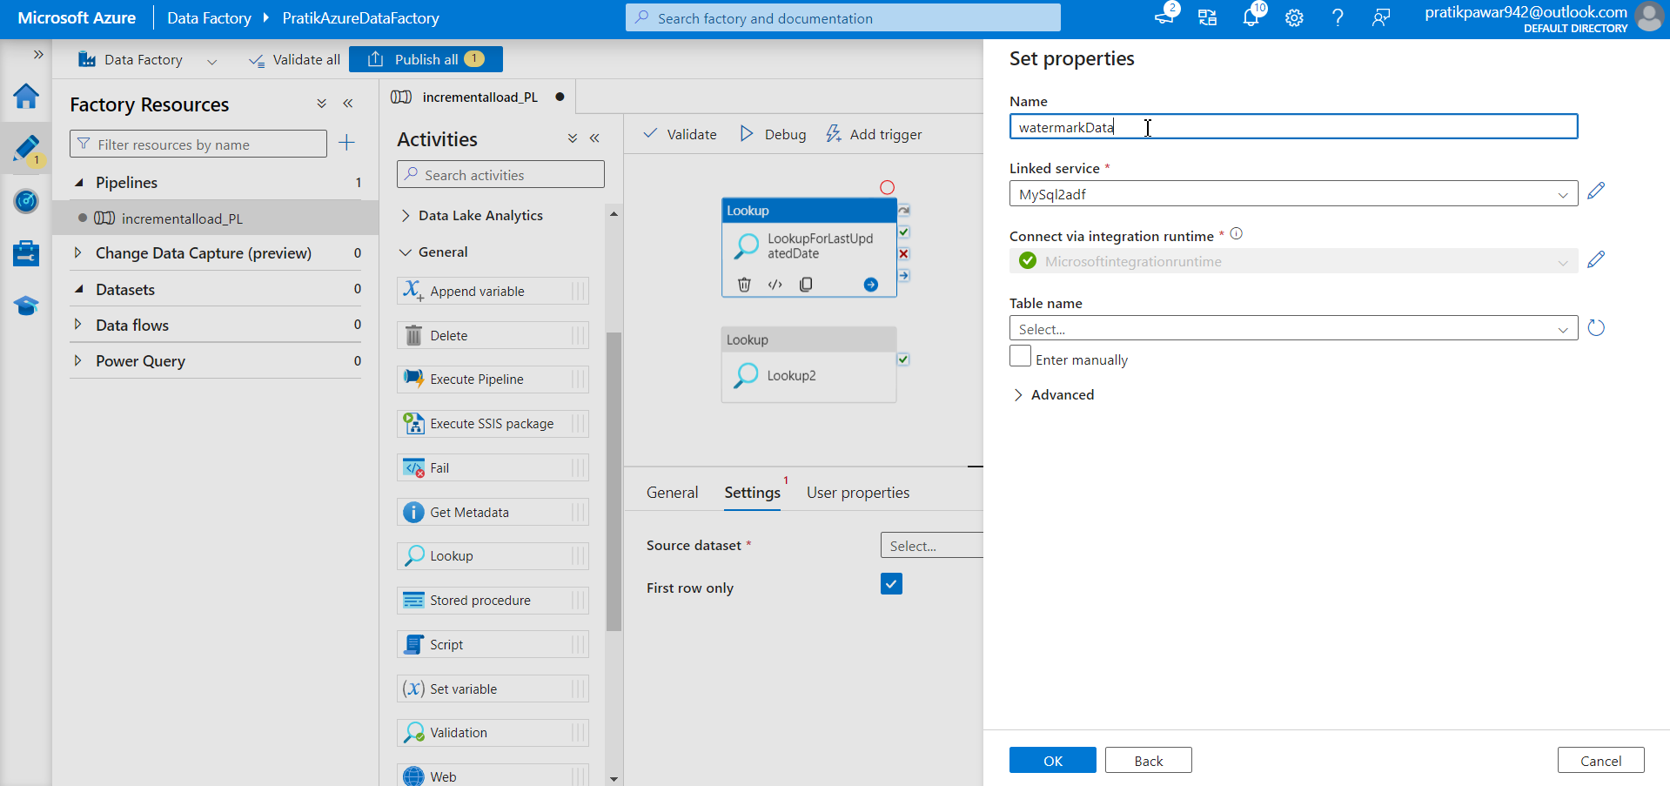
Give name as watermarkdata

Slide 26
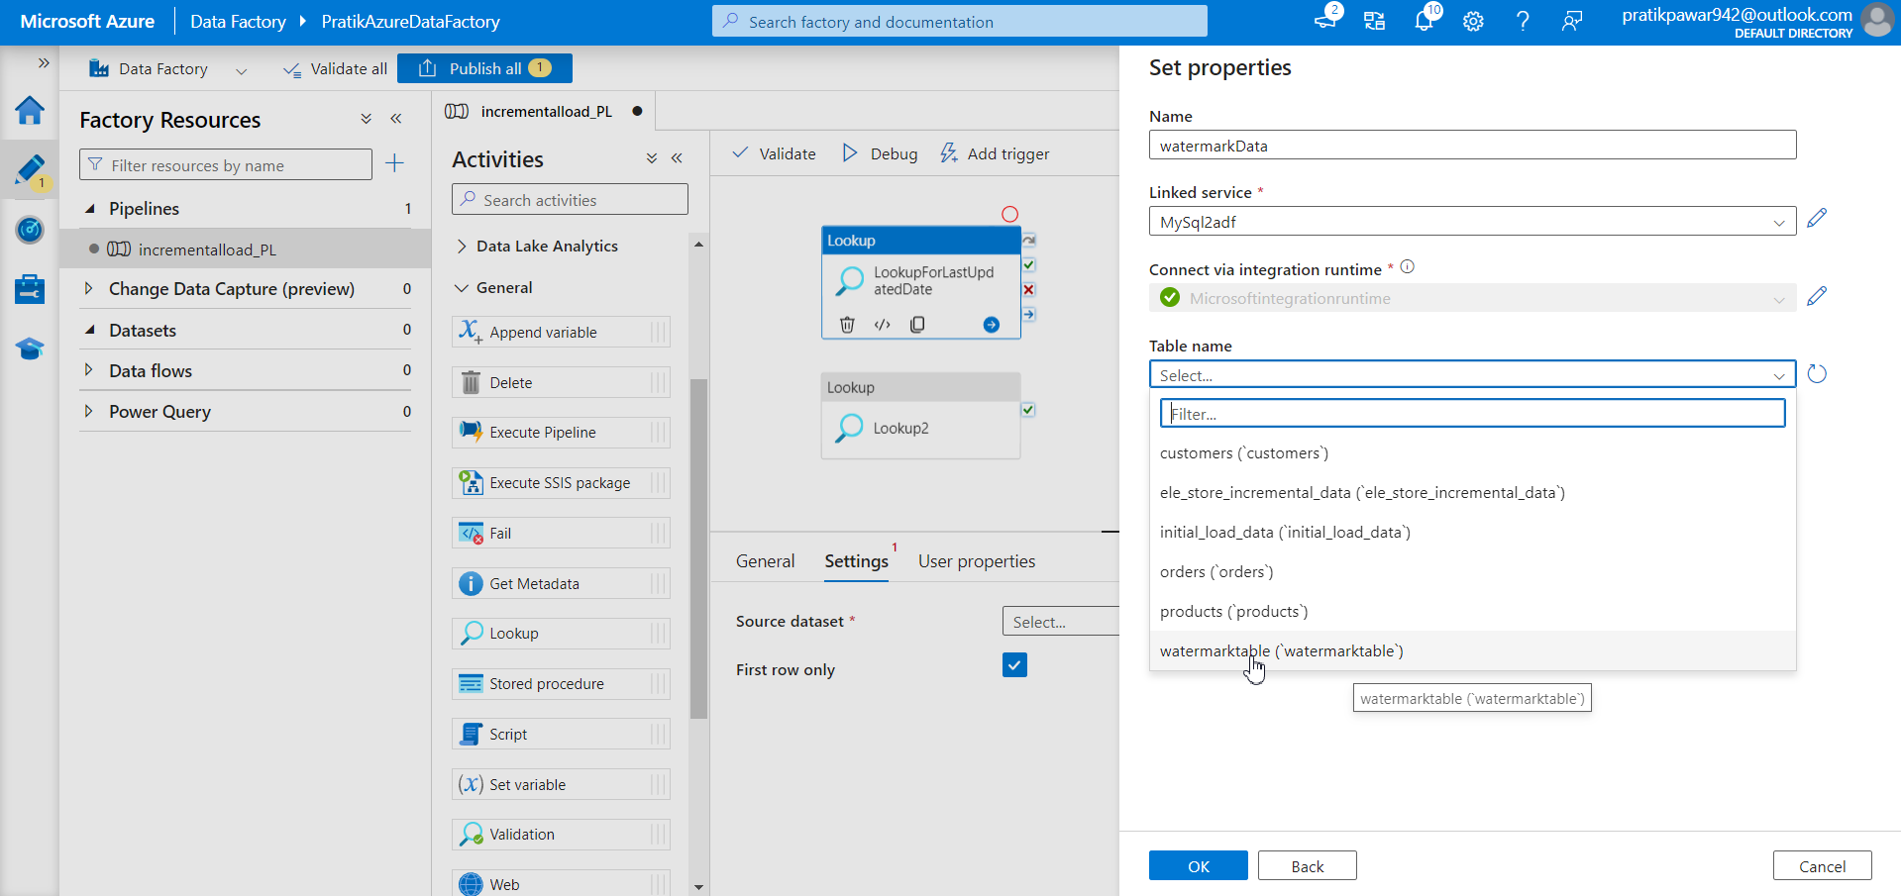
Select the watermark table which we have created

Slide 27
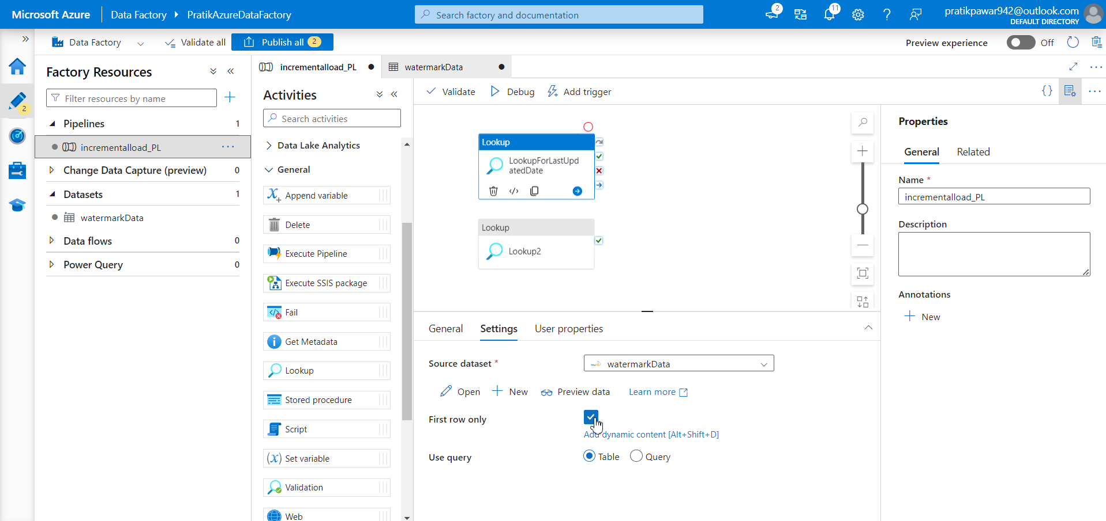
Uncheck the ‘first row only’ option and preview data

Slide 28
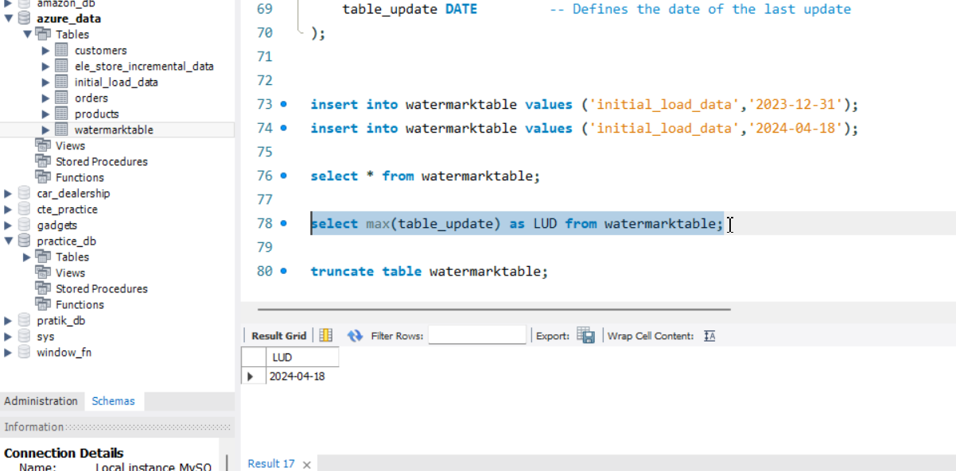
We have to take max of table date ie new records date (LUD – last updated date)

Slide 29
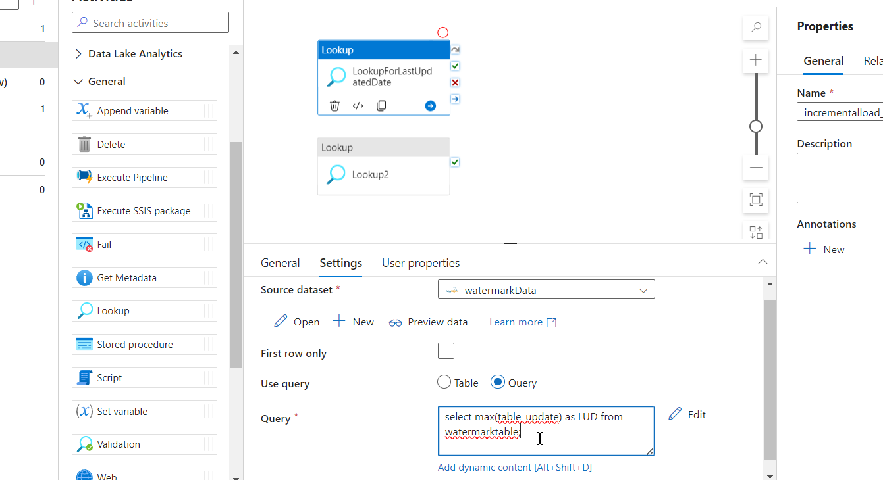
Just copy the query and paste it here to only add last updated date of new data

Slide 30
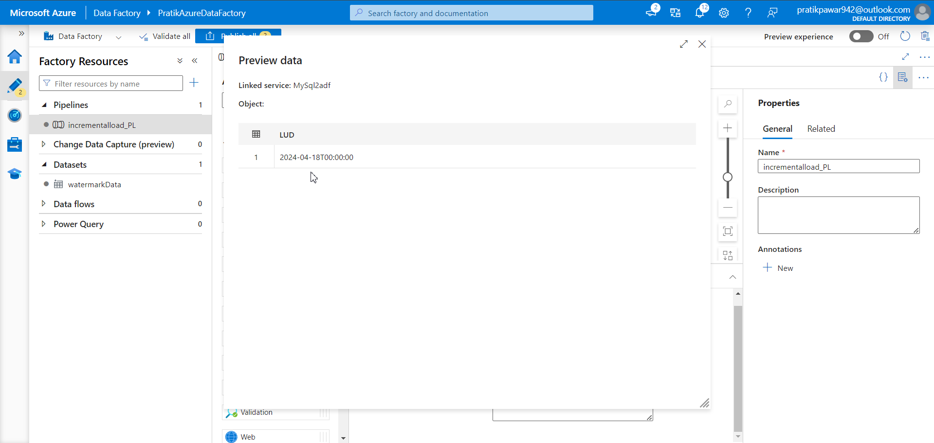
Preview data

Slide 31
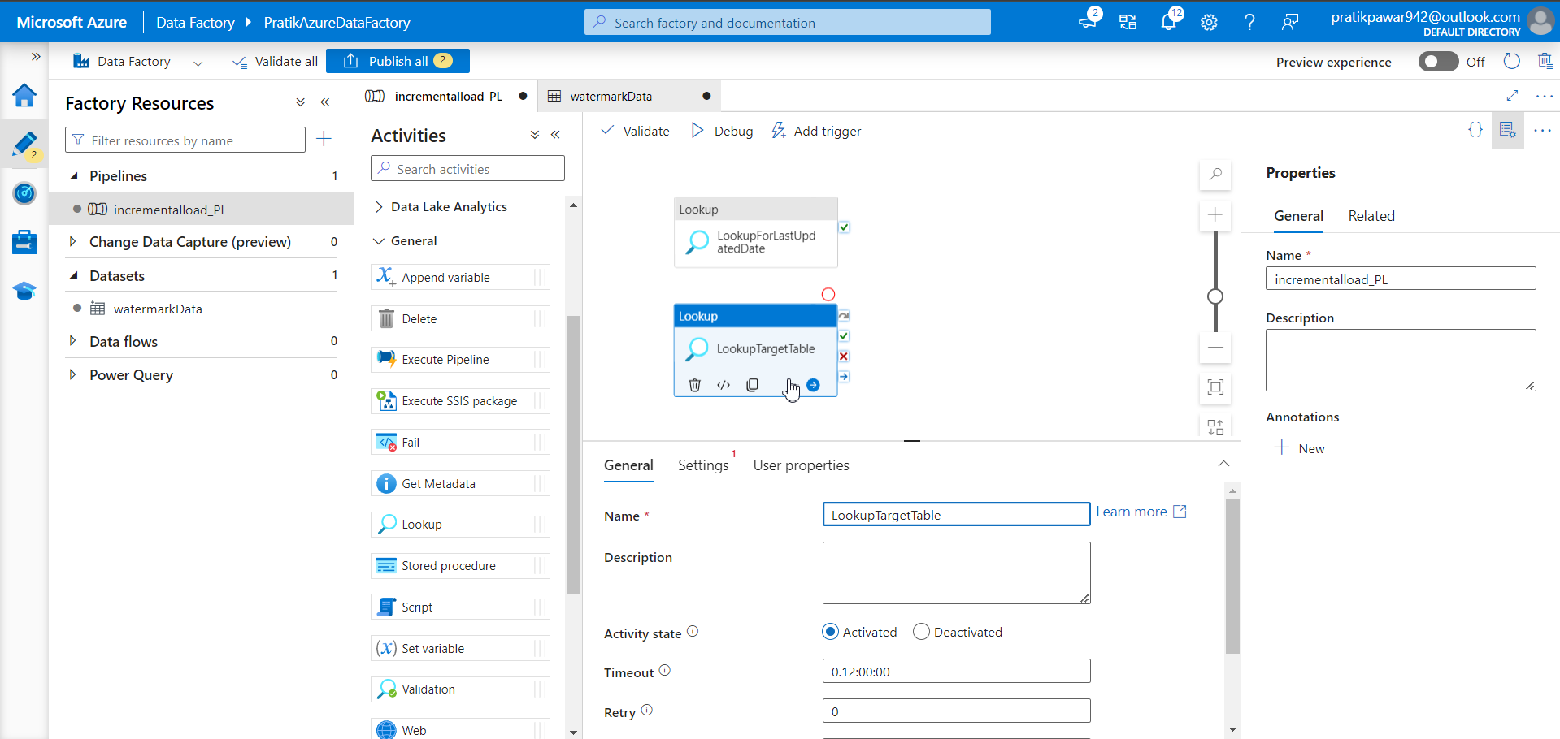
Name another lookup as ‘LookupTargetTable’

Slide 32
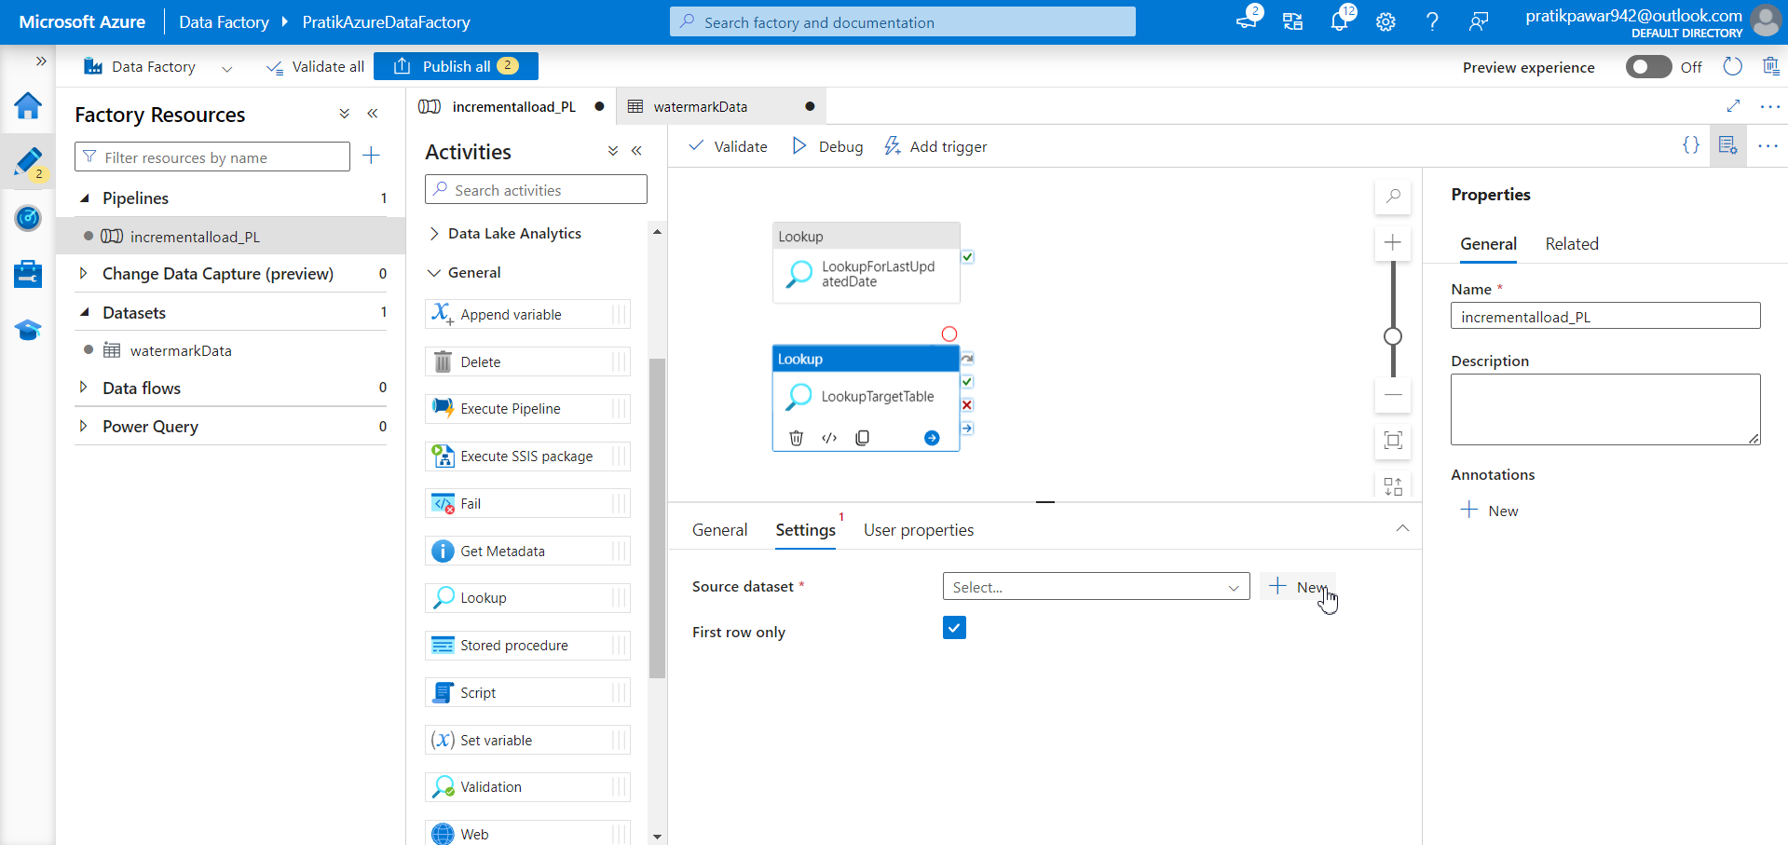
Go to settings and select target table from Azure SQL Server

Slide 33
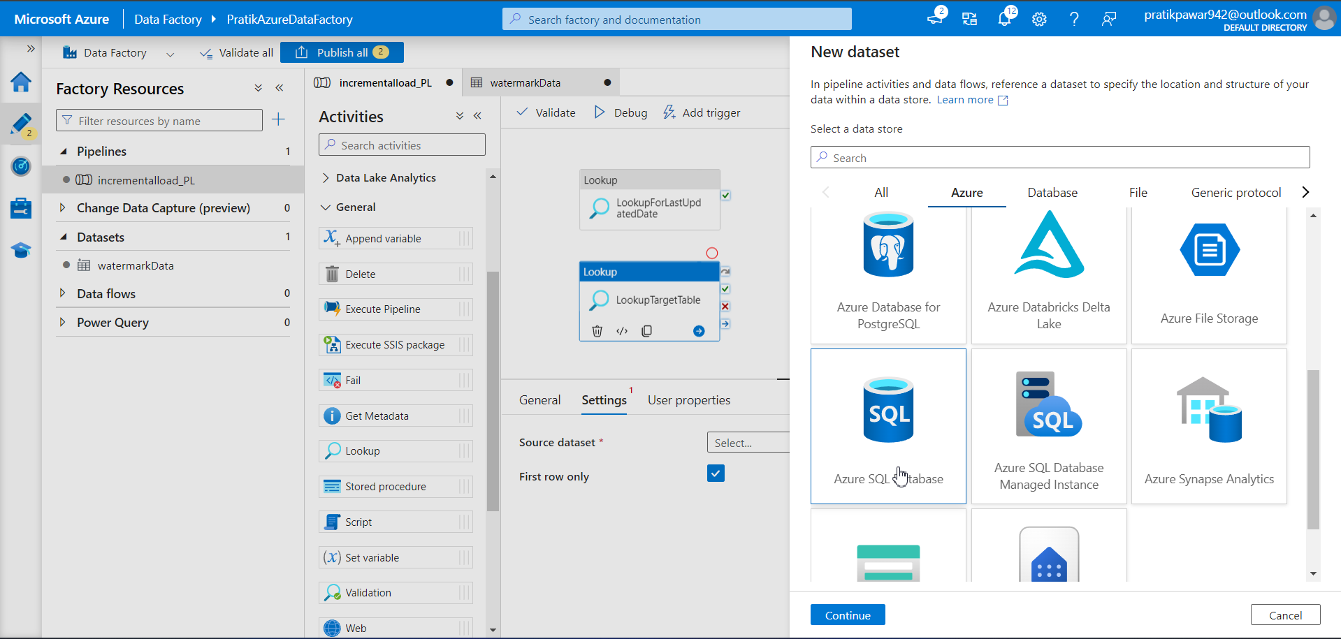
AZURE SQL Database

Slide 34
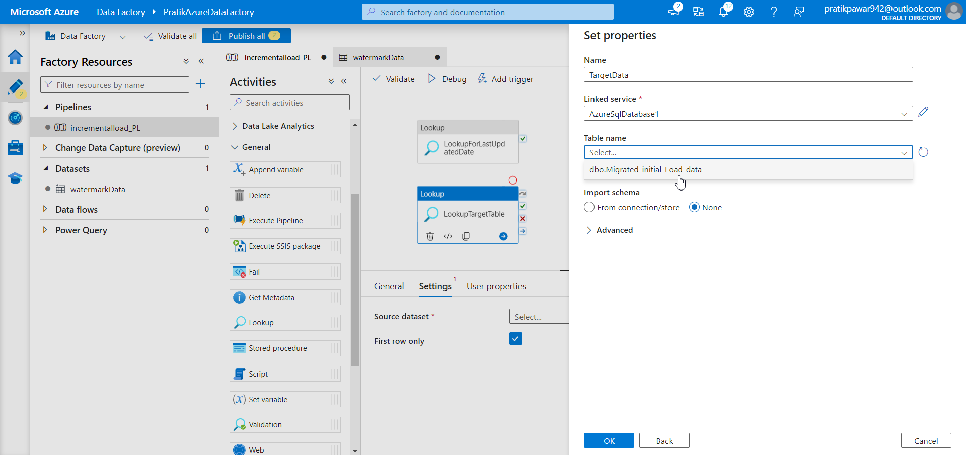
Give Name, Linked Service and Select table from azure SQL Database ie migrated_initial_load_data

Slide 35
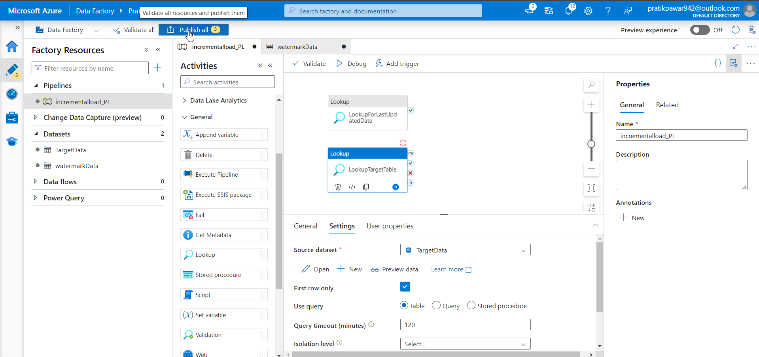
Publish all

Slide 36
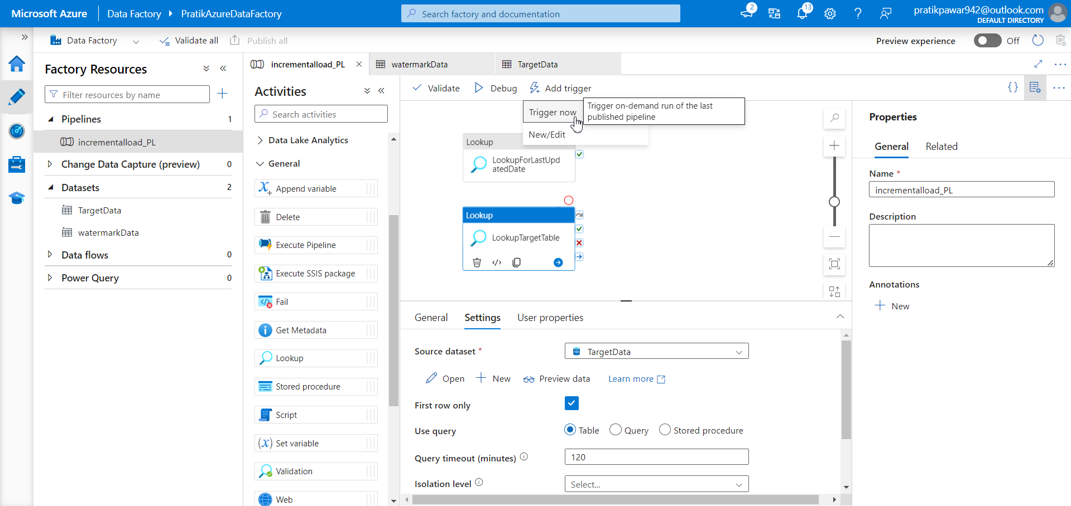
Now we just trigger both lookup activities

Slide 37
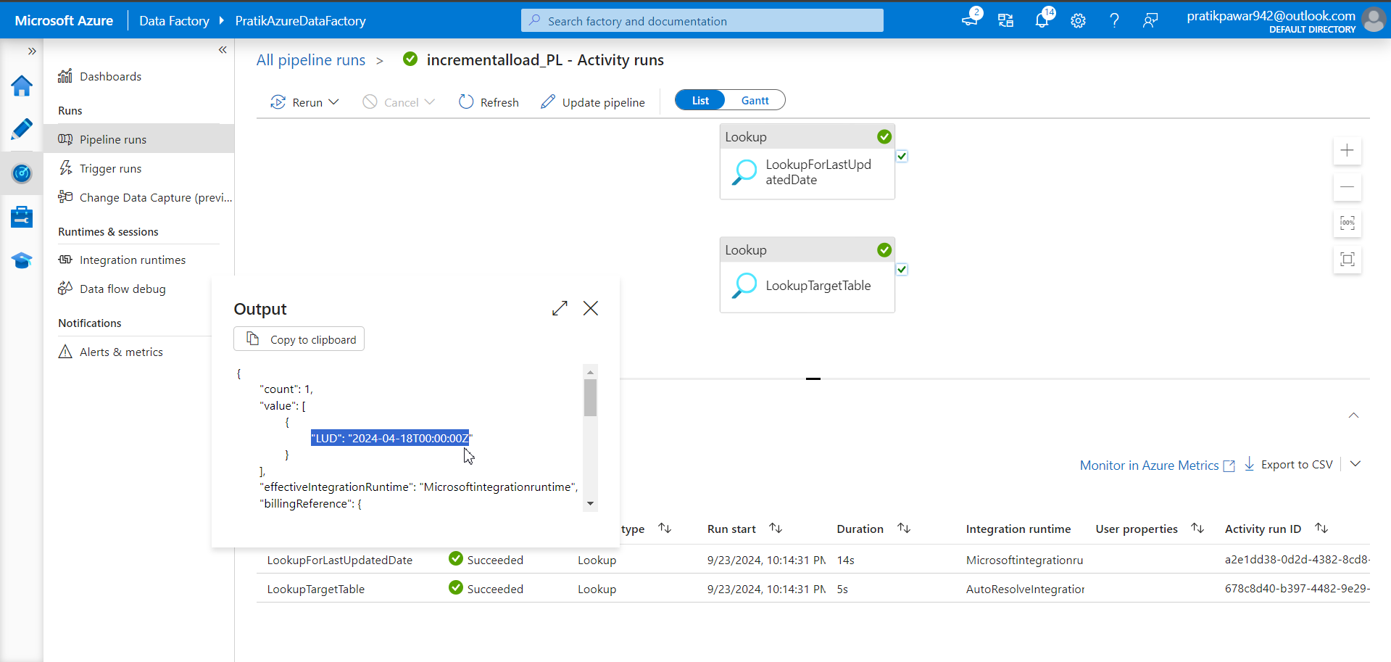
In first we get our selected date value

Slide 38
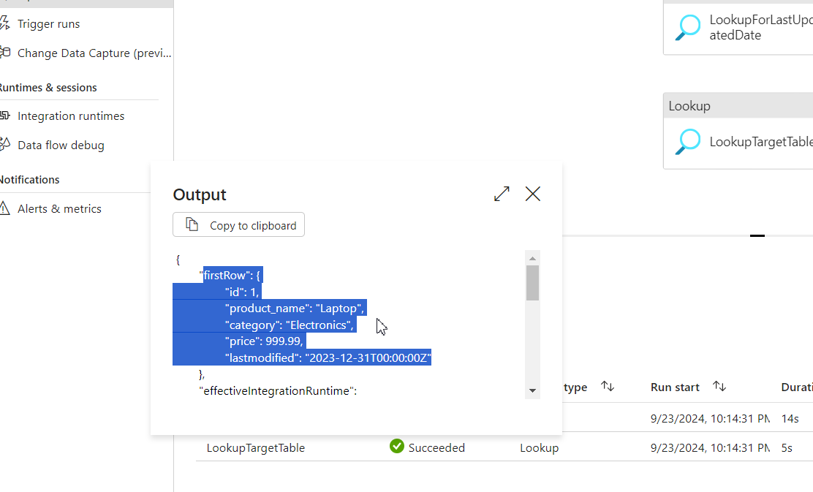
In second we get column name and their first record

Slide 39
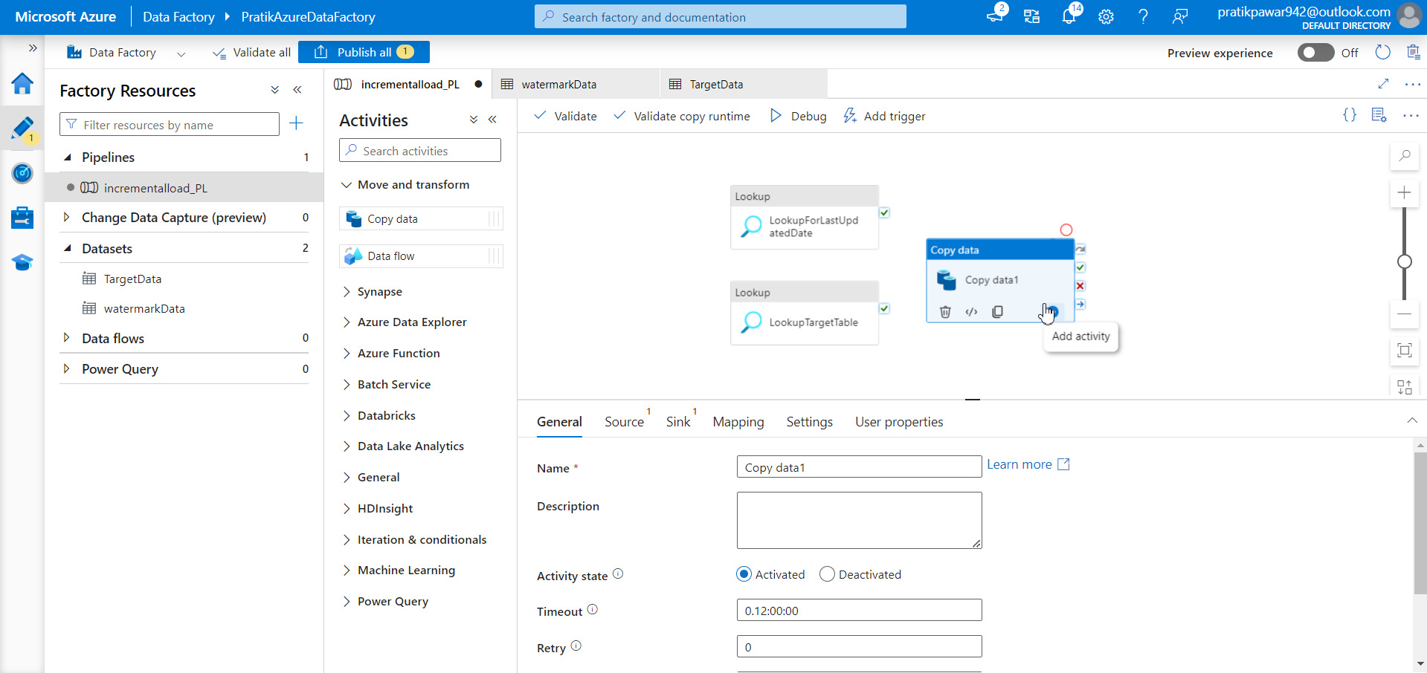
Go to incrementalload_PL > copy data and paste it in pipeline canvas

Slide 40
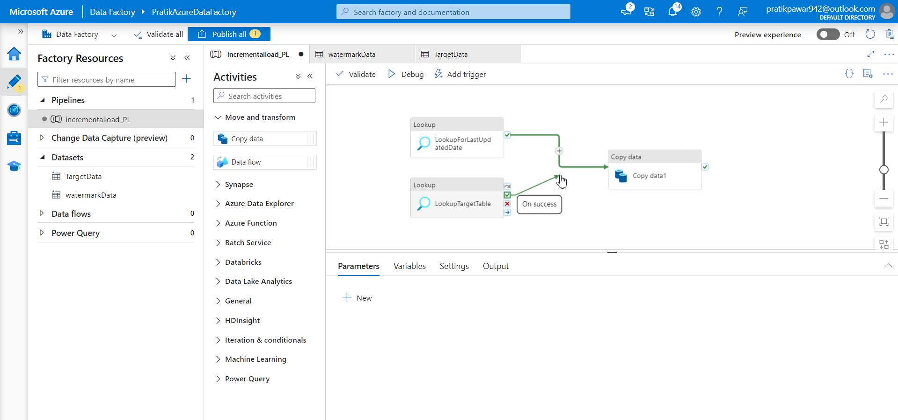
Now join both lookup to copy data

Slide 41
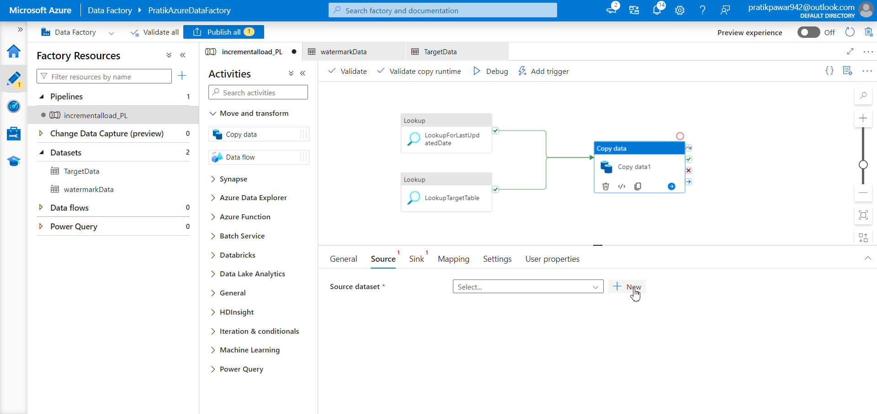
Now add source where we will get new records or data ie onprem MySQL

Slide 42
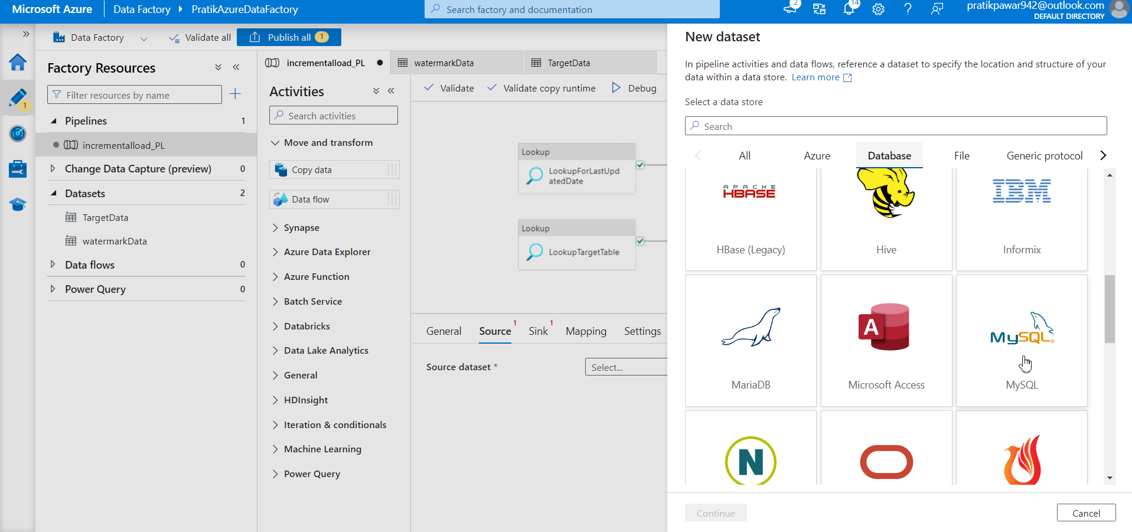
MySQL

Slide 43
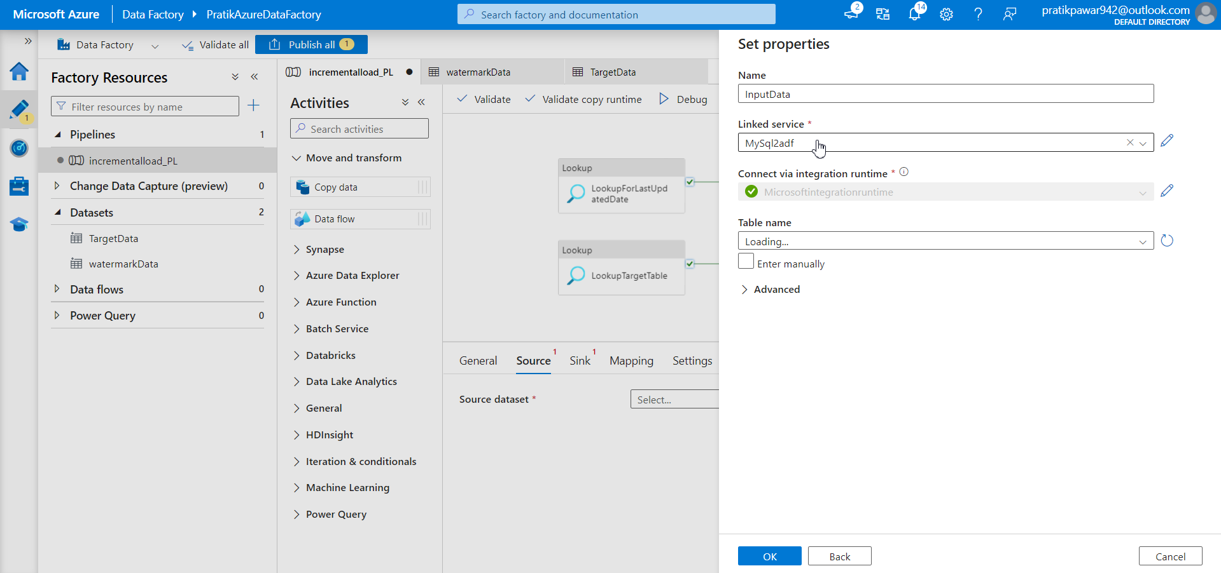
Rename as InputData and select linked service

Slide 44
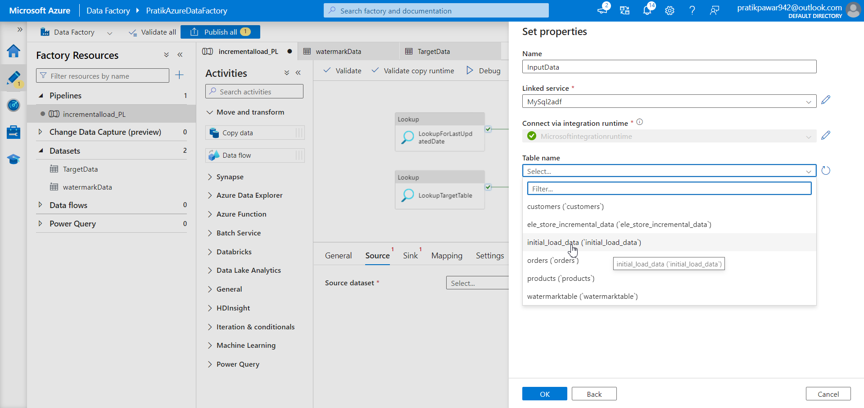
Open the table which having new data with old data ie initial_load_data

Slide 45
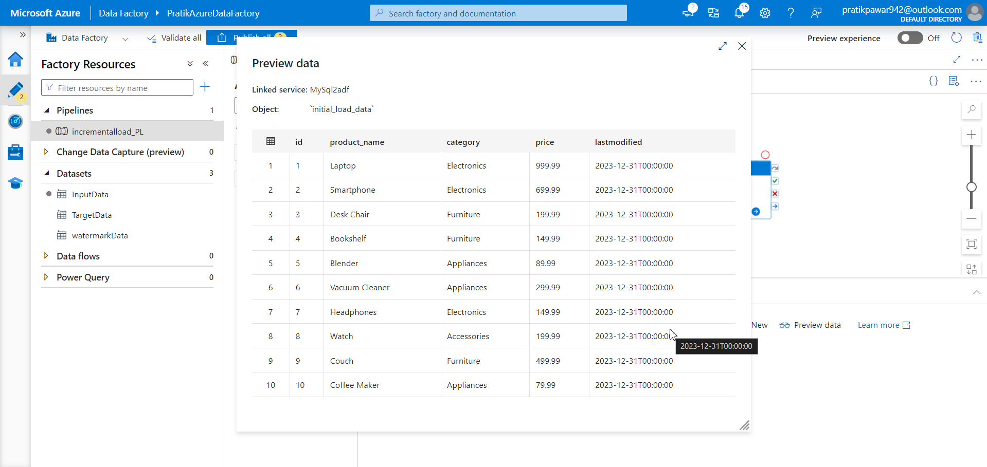
Preview data

Slide 46
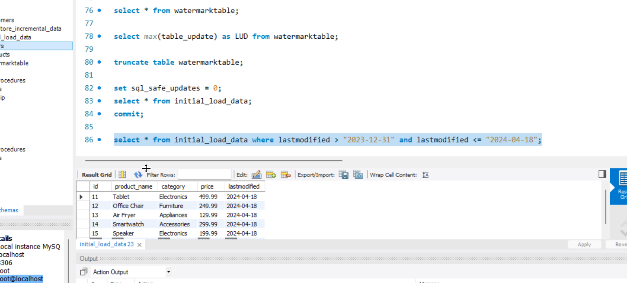
From this query we get the new records which we are going to insert in old table in azure sql database

Slide 47
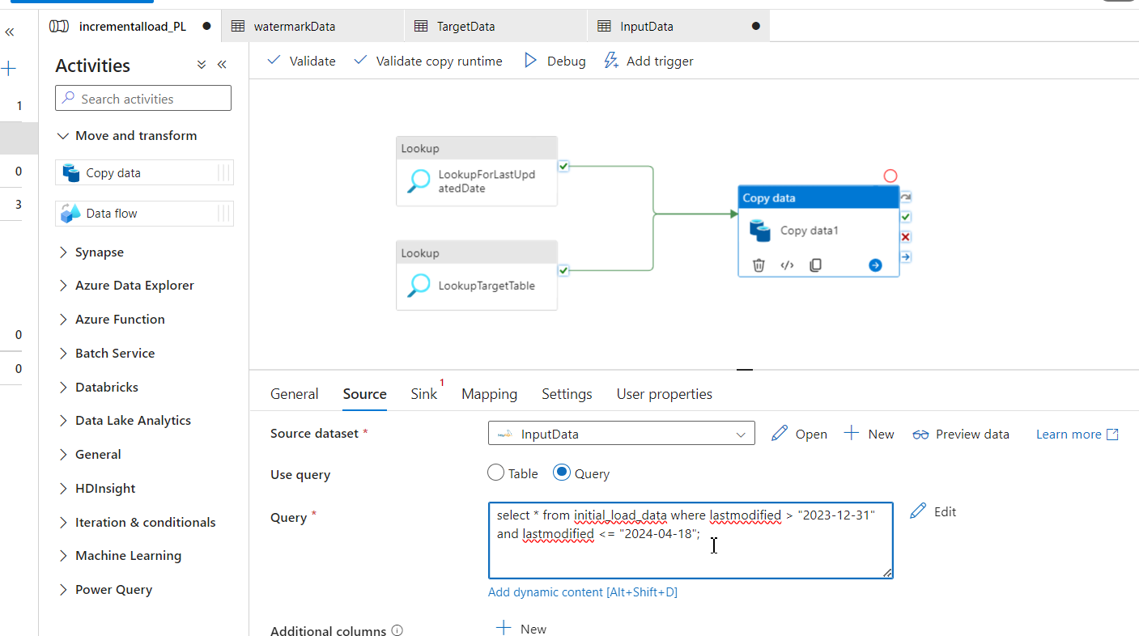
Now copy the query and paste it in source query table to insert new data only ie incremental data

Slide 48
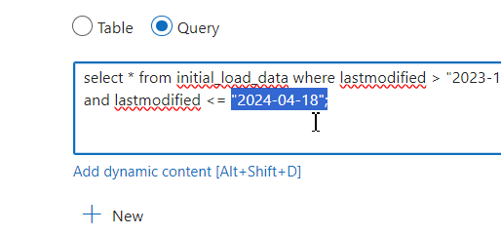
But 2024-04-18 is hard coded value so everytime we have to change the value when new data comes.so…

Slide 49
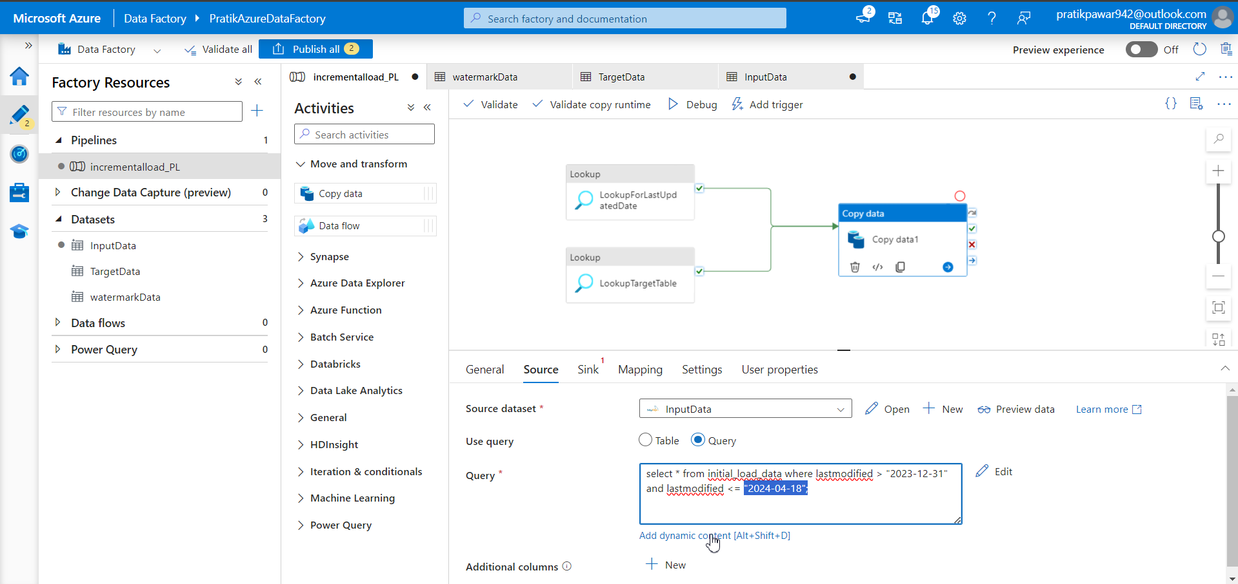
So, we have to write dynamic content for automation of value change

Slide 50
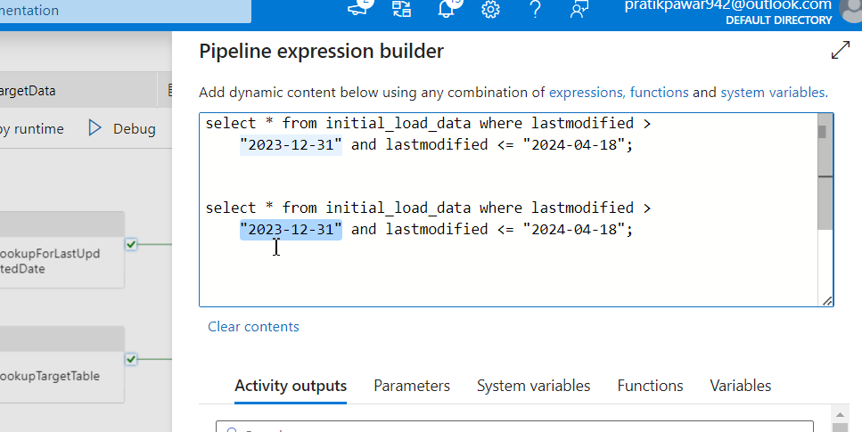
Now instead of data we have to add look up code there so remove data and type @ symbol to get lookup activity code

Slide 51
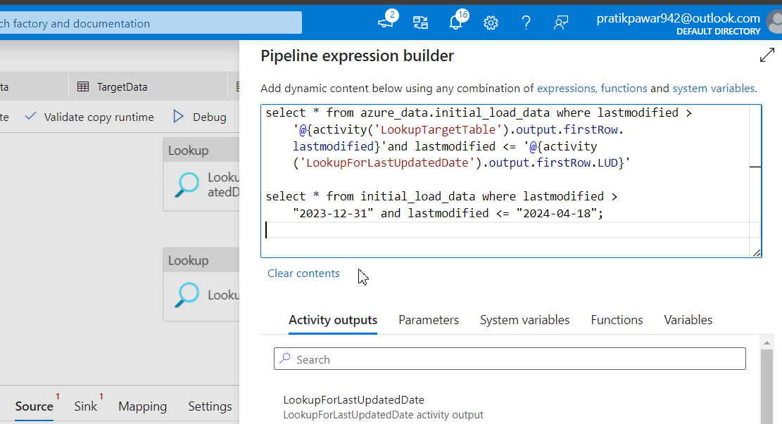
Compare both the codes to understand it

Slide 52

Write the dynamic code and press ok

Slide 53

Create sink for incremental data

Slide 54

Azure SQL Database

Slide 55

Give name,select linked service and select initial load data so to add incremental load data

Slide 56

Publish and trigger now

Slide 57

Pipeline have failed due to some error

Slide 58

We have just updated the dynamic code

Slide 59
Explanation of dynamic code
Explanation:
@{activity('LookupTargetTable').output.value[0].lastmodified}:
This part refers to the result of the LookupTargetTable activity in Azure Data Factory.
Specifically, it's accessing the lastmodified field from the first row (index [0]) of the data returned by this Lookup activity.
It is converted into a date format using the date() function.
@{activity('LookupForLastUpdatedDate').output.value[0]['LUD']}:
Similar to the first part, this accesses the result of the LookupForLastUpdatedDate activity.
It retrieves the value from the LUD (Last Updated Date) field from the first row and converts it into a date format with date().
Query Logic:
The query is selecting all records from the azure_data.initial_load_data table where the lastmodified date:
Is greater than the lastmodified value retrieved from LookupTargetTable.
Is less than or equal to the LUD (Last Updated Date) from LookupForLastUpdatedDate.
In Simple Words:
This query is fetching rows from initial_load_data where the lastmodified date falls between two dates:
One date comes from the output of LookupTargetTable.
The other date comes from the output of LookupForLastUpdatedDate.
Purpose:
It's used for incremental data loading, where you're only loading or processing data that has been modified between specific dates.

Slide 60

Click details to see data is transfer or not

Slide 61

Successfully 5 rows have been load

Slide 62

Also here at first 10 records were there now 15. hence data has ben loaded successfully

